Slide 1
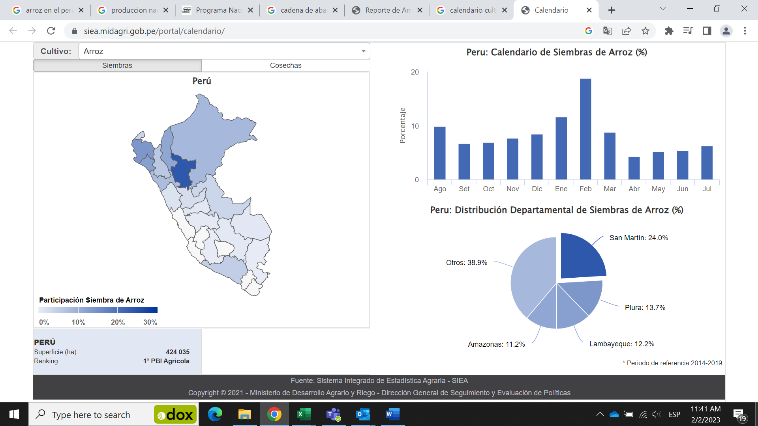
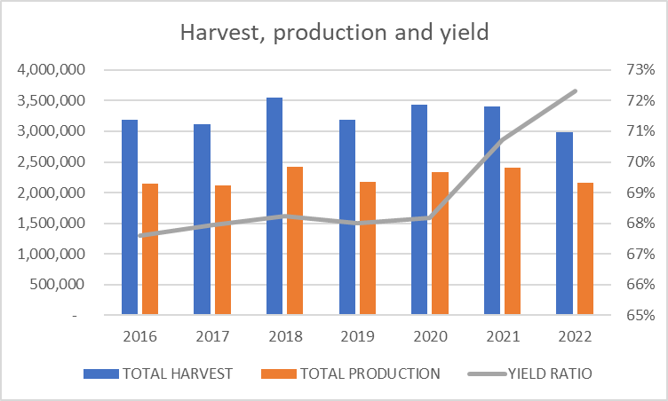

LOCAL PRODUCTION
PERUVIAN HARVEST IN MT
Tn (2022) | 2,978,133
N° ha | 410,000
Yield Tn/ha | 7,500
N° farmers | 14,000
Irrigation | 15,000m³/ha
40%
1,155k
30%
887k
10%
280k
Source: Ministry of Agriculture
PERUVIAN PRODUCTIONS & YIELD
Source: Ministry of Agriculture
1

Slide 2
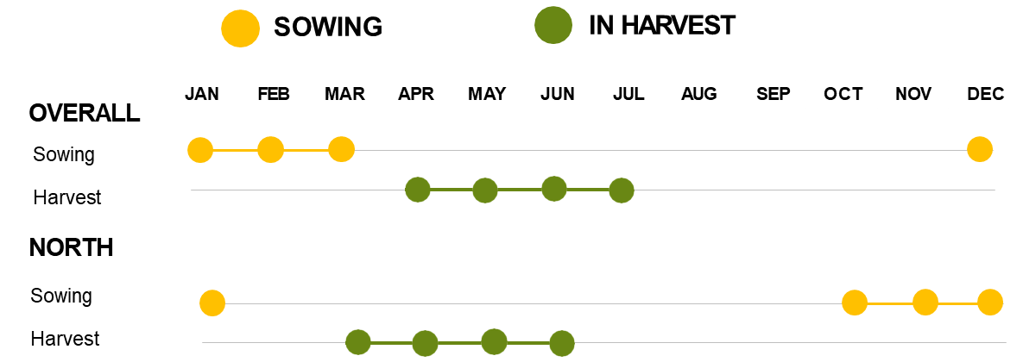
SEEDS VARIETIES
Varieties developed by National Institute of Agrarian Researching:
NIR
Amazonas
Fuerón
Pitipo
Tinajones
Valor
Capoteña
Pacamuros
Mayares
La Puntilla
IR43
Lifetime raw material: 3 years
Lifetime final product: 3 months
SEEDS – 50% use certified
Source: Meeting National Institute of Agricultural Research (Eng. Montero)
2
Source: Meeting National Institute of Agricultural Research (Eng. Montero)

Slide 3
PERUVIAN CONSUMPTION
520k MT/y
(25%)
800k MT/y
(35%)
Source: Ministry of Agriculture
3

Slide 4
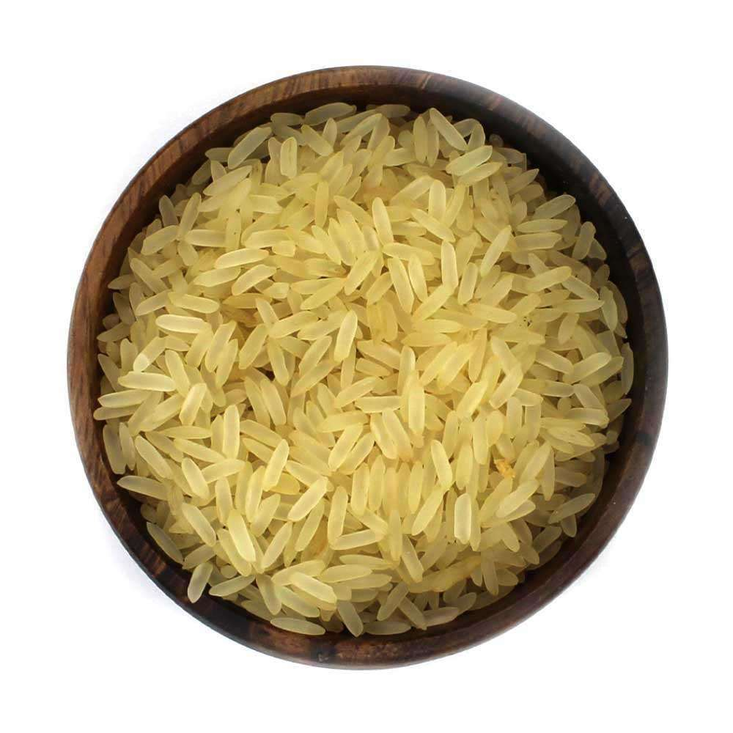
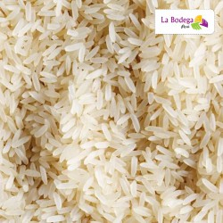
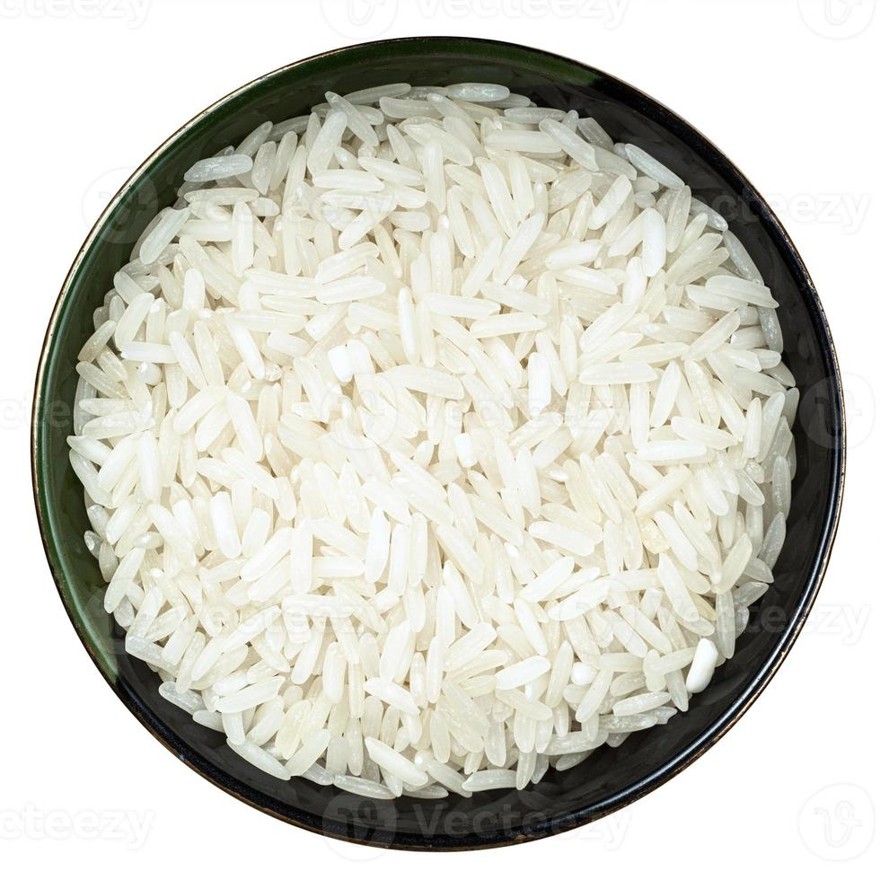
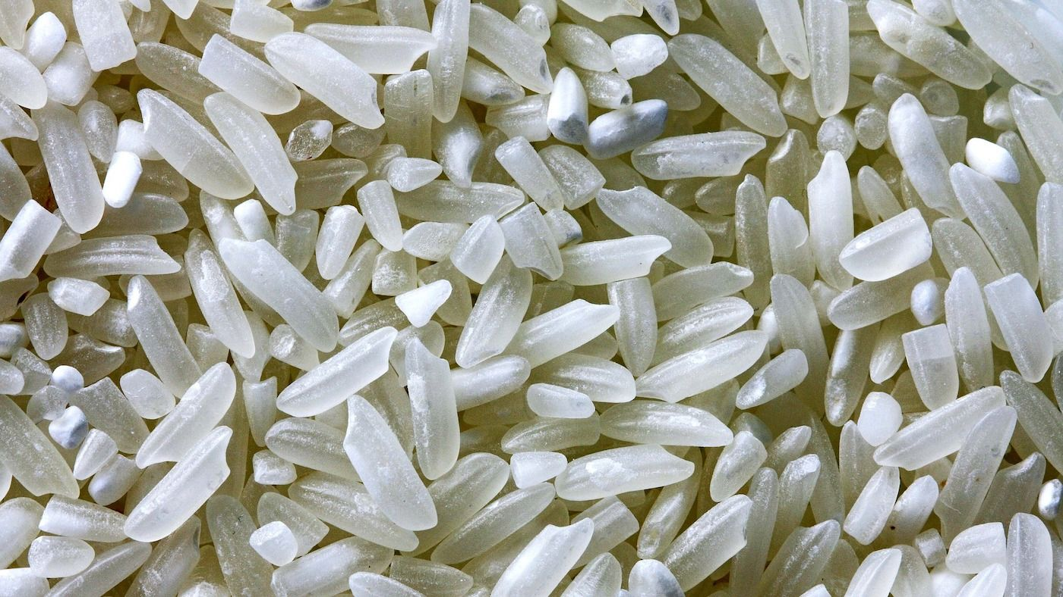
COMMERCIAL VARIETIES
Source: Spec Brand El Gran Chalan and meeting with stores in wholesale market
AÑEJO
EXTRA
SUPERIOR
CORRIENTE
4

Slide 5
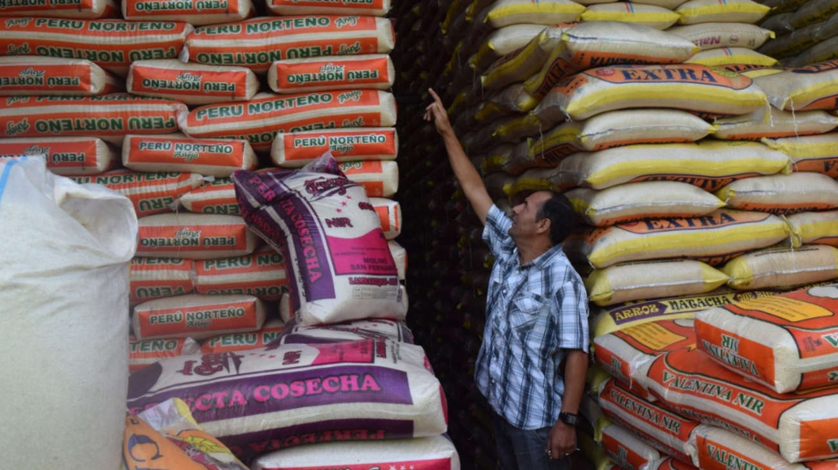
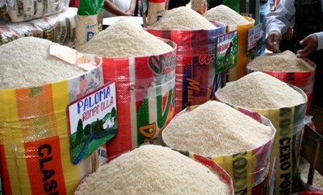
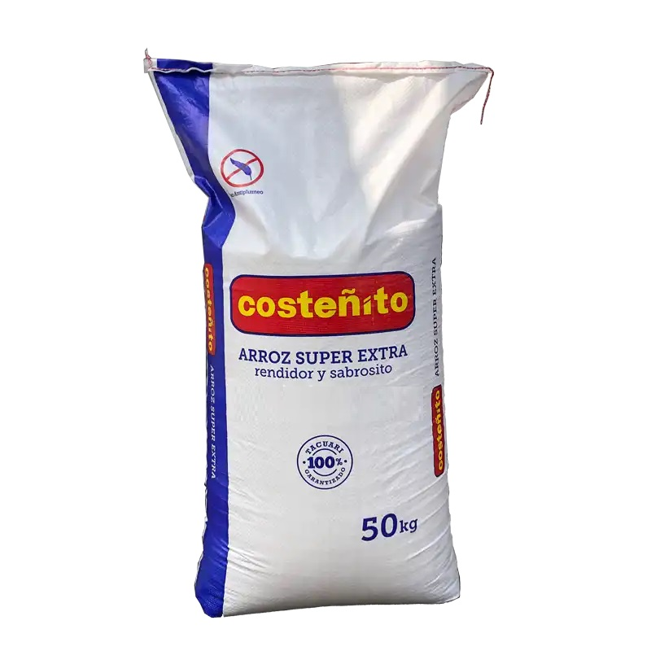
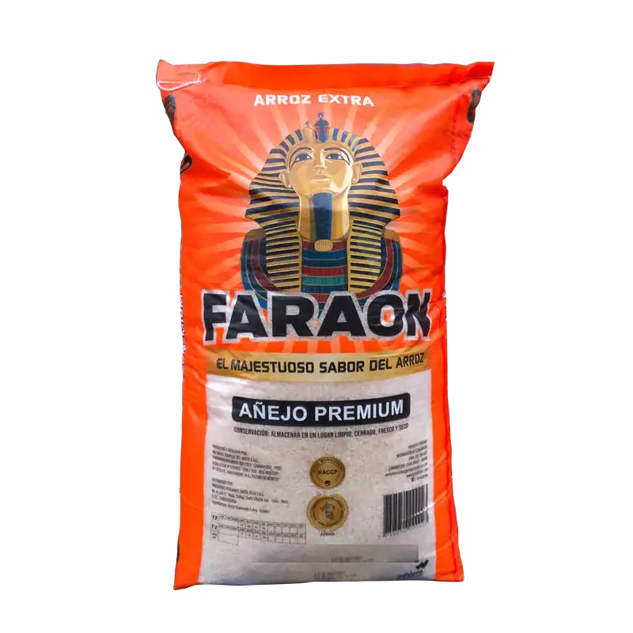
PACKING BULK
TOTAL PERUVIAN CONSUMPTION BULK & RETAIL
Source: Meeting with millers and supermaket
BULK Presentation are 49kg and 50Kg.
Represents 1.4 millions of MT.
Sell points:
Local markets in all the country
Wholesaler markets
5

Slide 6
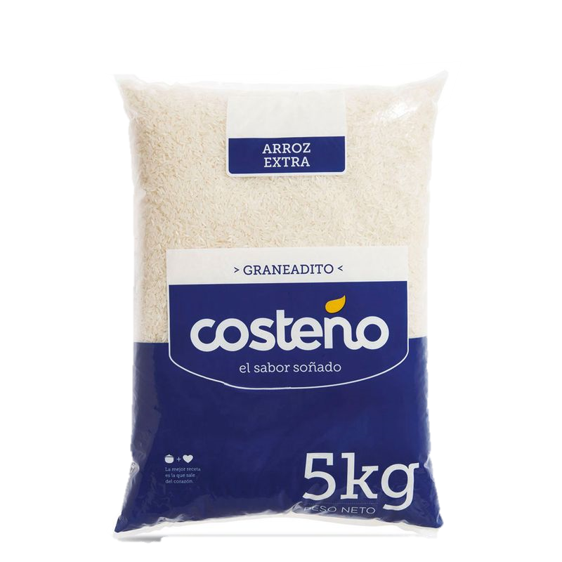
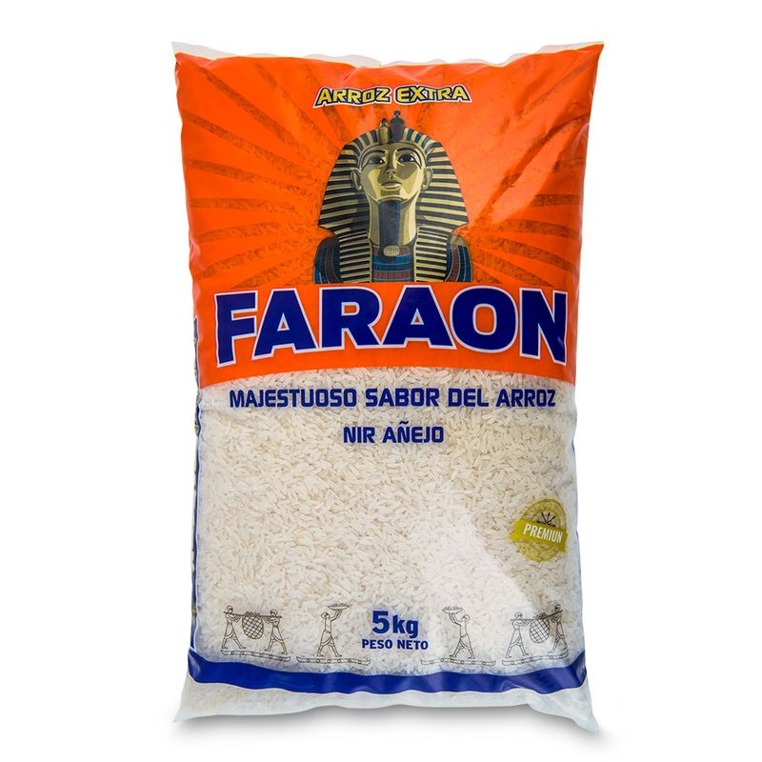
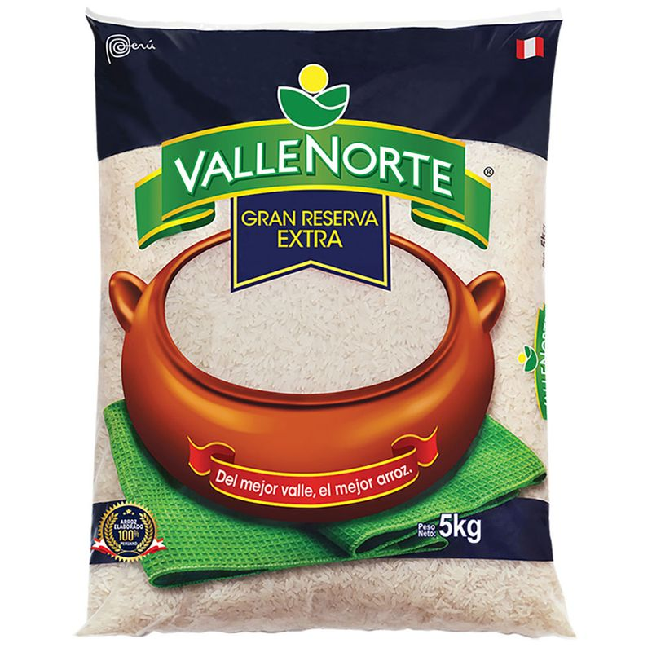
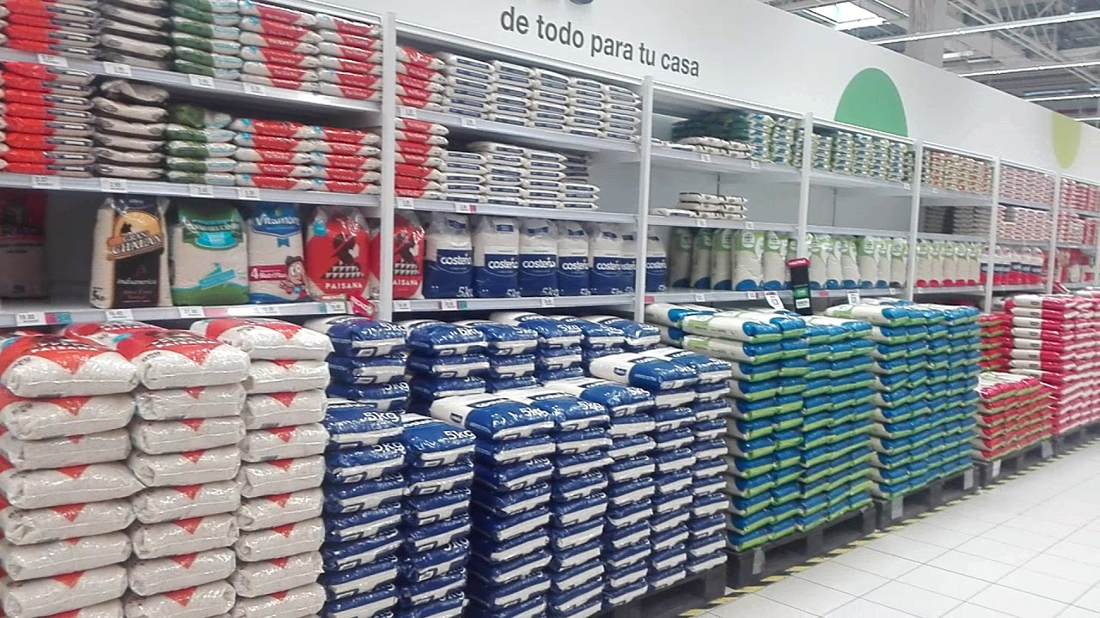
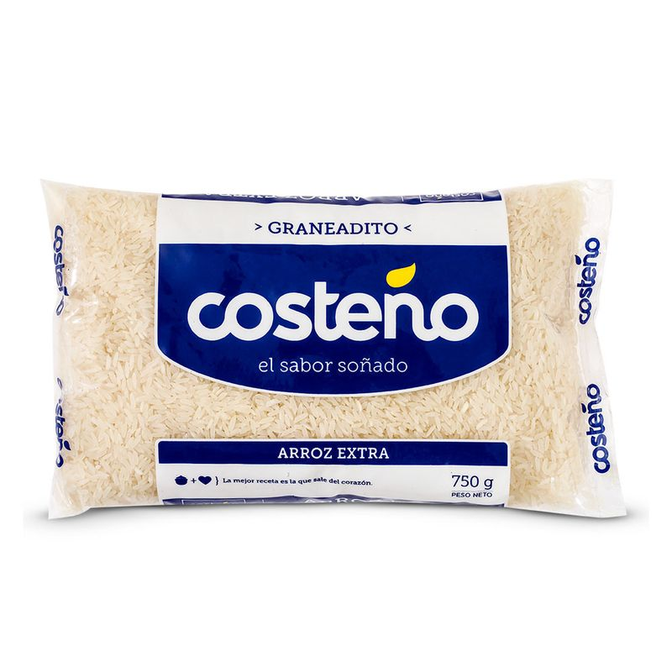
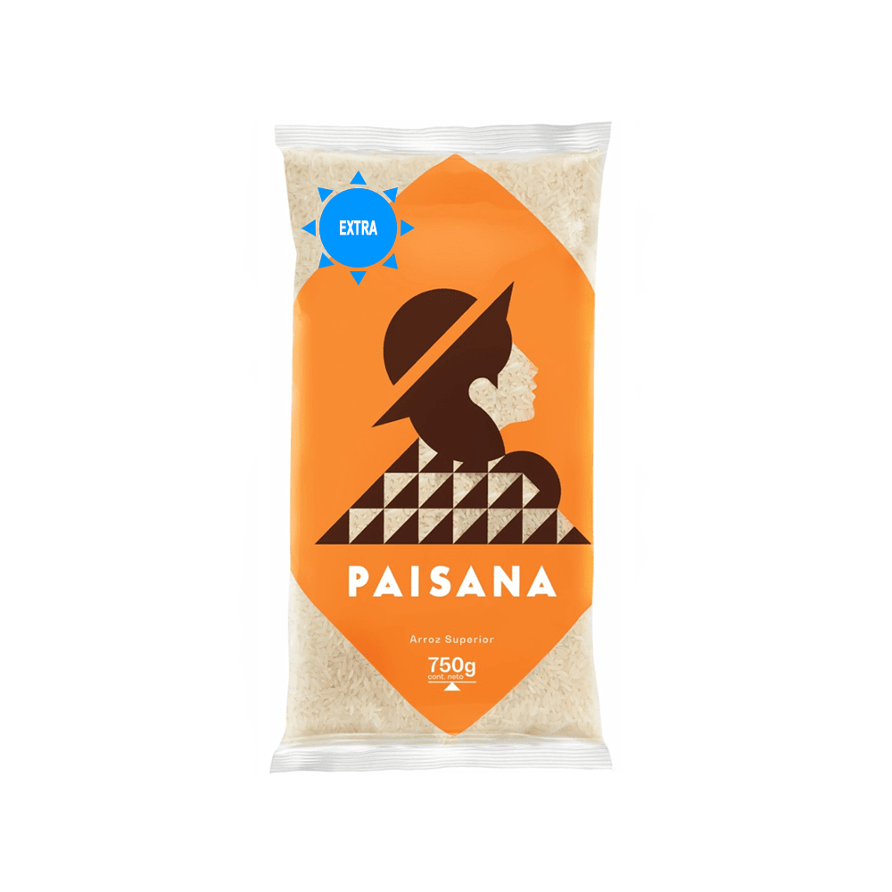
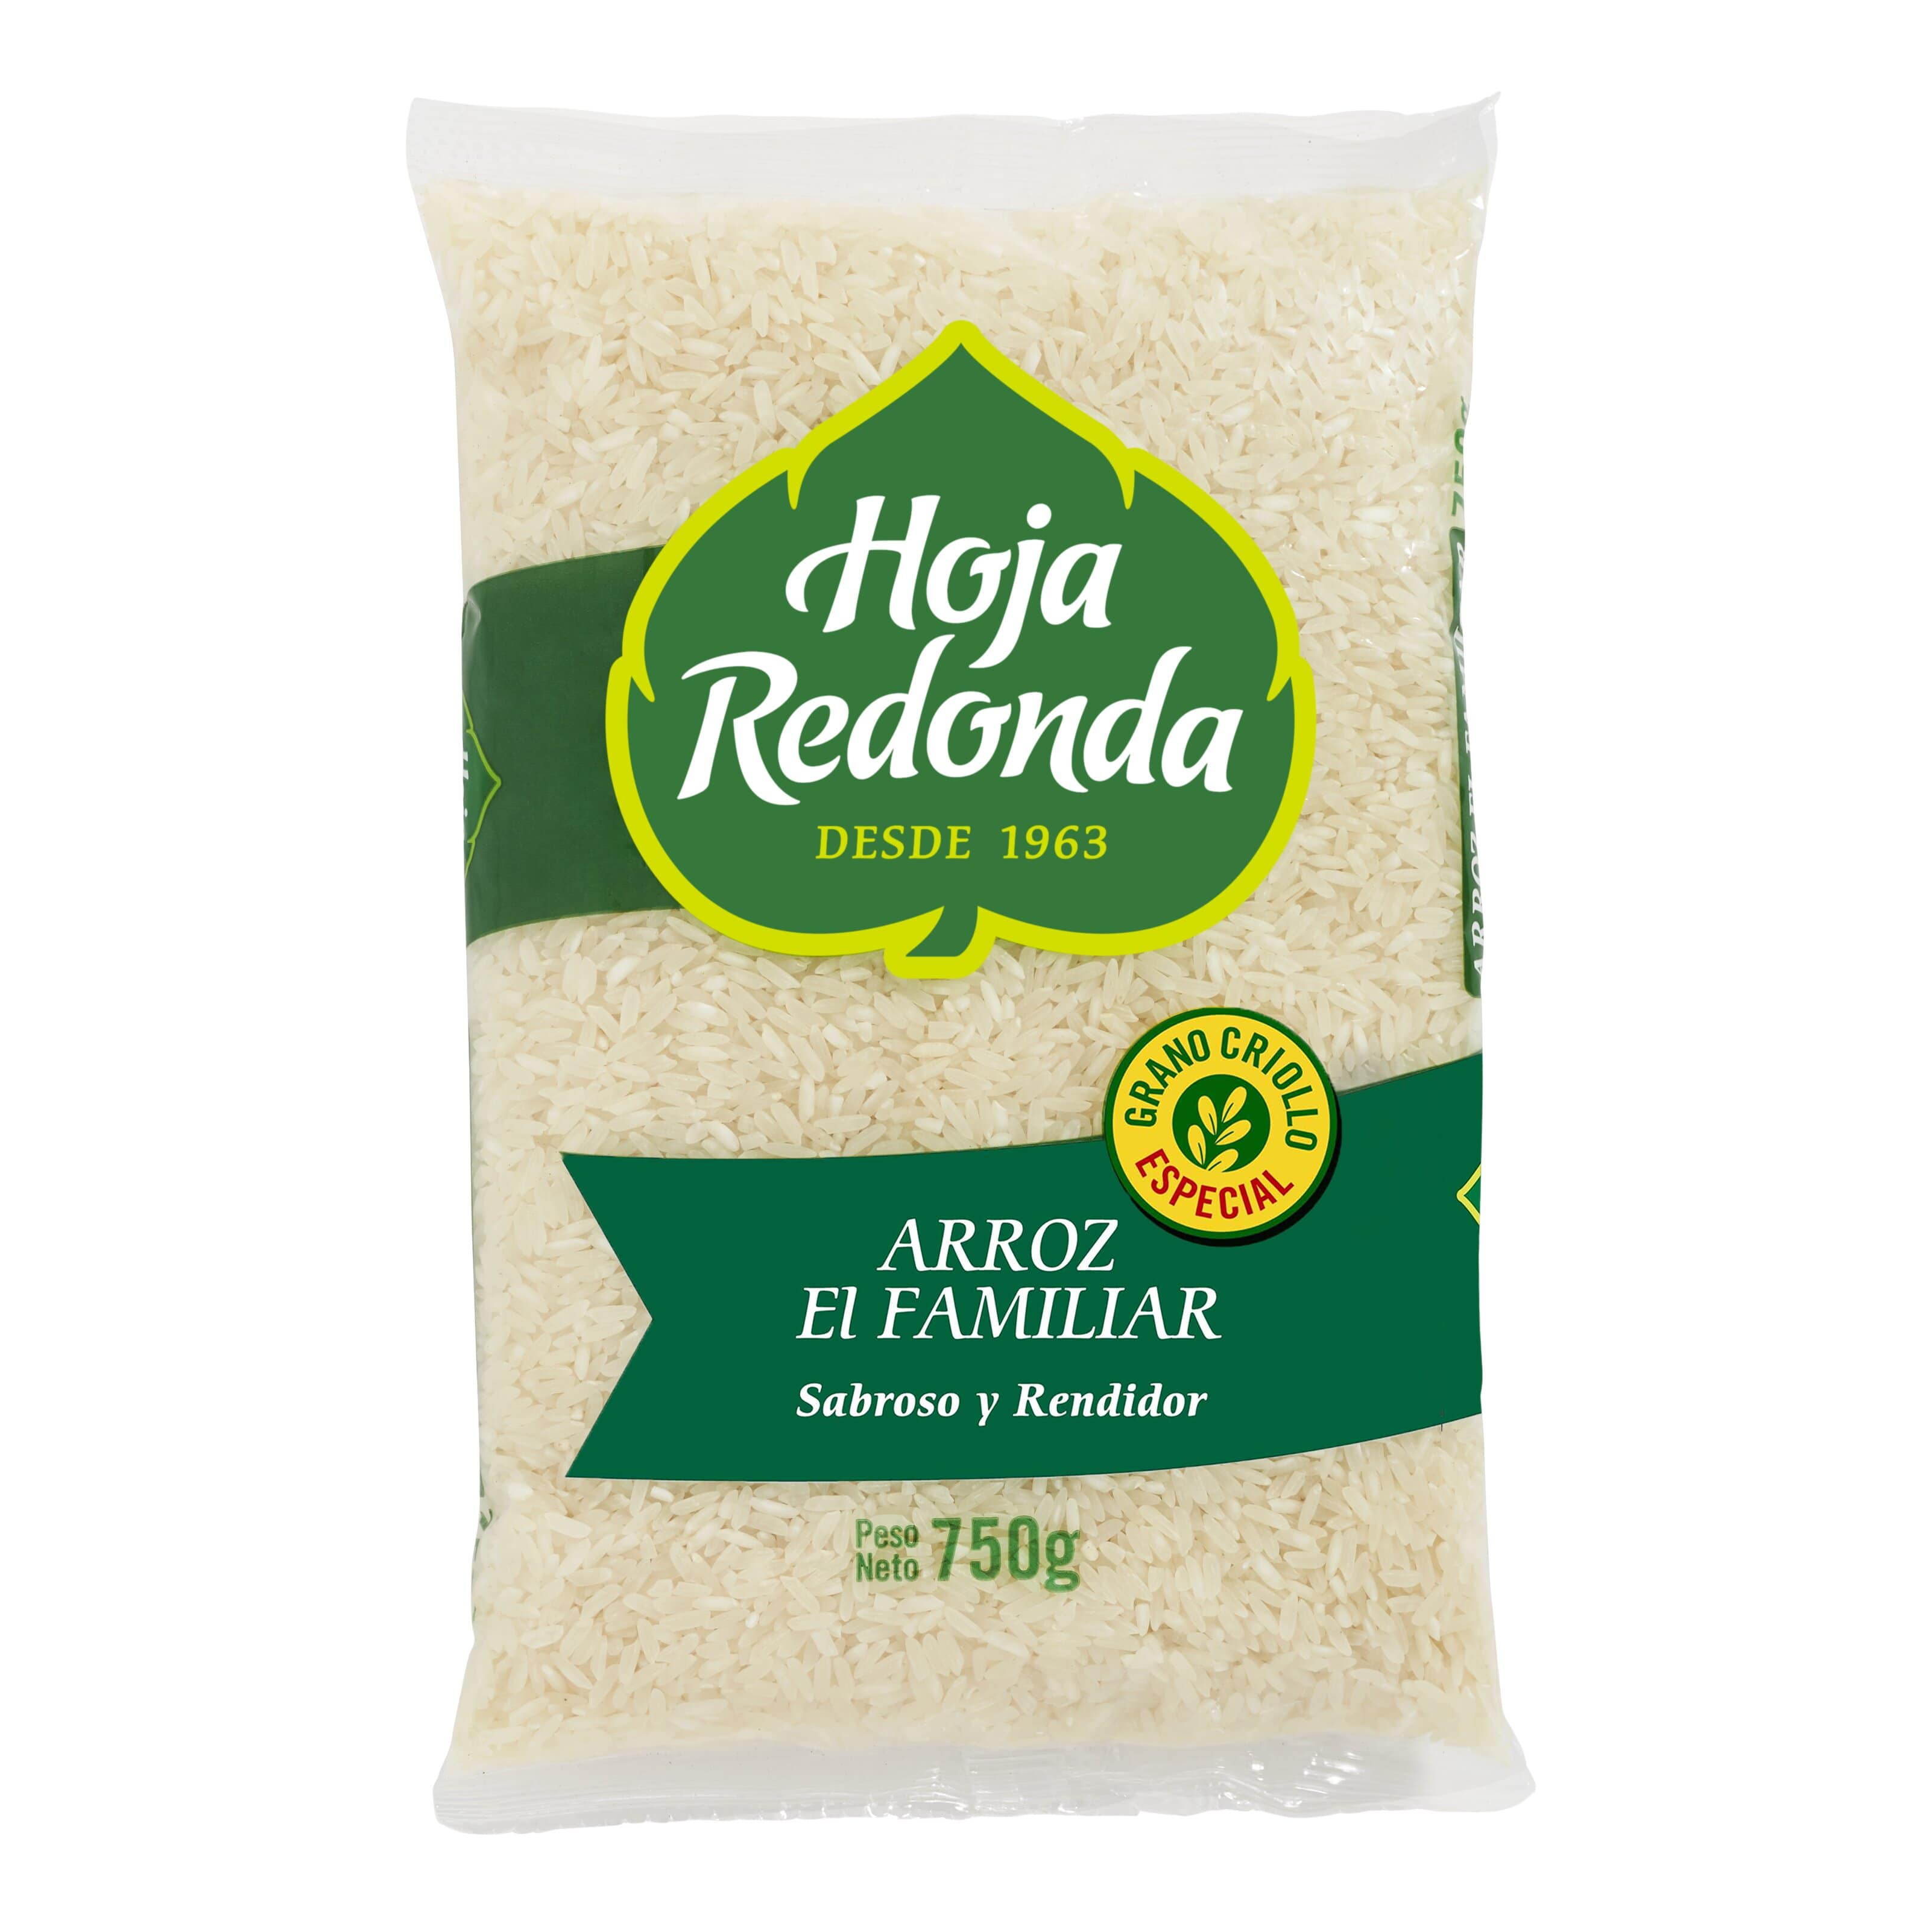
PACKING RETAIL
Presentations of 5kg and 750g
5kg
Selling points:
Local stores
Supermarkets
Local markets
750g
6

Slide 7
PROCCESSING – MILLS
In charge of Collect, process & pack rice.
Nationalwide: Aprox 600 mills and 550 WHs
Estimated that 30 – 40 mills concentrated the main national offer.
Product from jungle is brought to the coast to be processed.
7

Slide 8
PROCCESSING – FLOWCHART
Cleaning
Drying
Hulling
Milling
Rice whitening
Polishing
Grading
Packing
8

Slide 9
PROCCESSING – MILLS
Finance:
MAIN MILLS IN THE NORTH OF PERU
Lack of work capital
Cash payment expected
Advance to farmers money or seeds.
Min Sanitary requirements:
Health Register (SENASA)
Operating license
Few mills have HACCP, BRC or other
Scope of distribution:
Wholesalers & markets, clients arrange the freight.
Supermarkets, mill arrange the delivery to DC.
Source: Meetings with Millers, Irrigation Board, Seeds Suppliers
9

Slide 10




MAIN SUPPLY CHAIN FOR BULK PRODUCTS – 65% of consumption
Farmers received credit from millers.
Product: Wet paddy rice.
Point of sale: in the farm.
Miller: Proccessing, packing in bulk.
Product: bags of 49Kg – 50Kg
Transport: Trucks 30MT floor loaded. Some also produce retail with own brands.
Main millers:
Saman (Lambayeque)
Molinera Tropical (Lambayeque)
La Cruz (Tumbes)
Molinos El Cholo (La Libertad)
Distributors scope are small stores, local markets and minimarkets. Distribute Retail and bulk.
Among the main brands: Costeño, Faraón, Gran Chalan, Valle del Norte, Paisana.
Mercado Santa Anita is the biggest wholesale Market in Peru. Have +20 stores specialized in rice. Trucks discharge directly in the Market.
Products: Imported and national rice in bulk
Clients: restaurants and local markets
Source: Meetings with Millers, Irrigation Board, Seeds Suppliers
10

Slide 11

MAIN SUPPLY CHAIN FOR SUPERMARKETS – 30% represents retail consumption
Farmers received credit from millers.
Product: Wet paddy rice.
Point of sale: in the farm.
Miller: Proccessing, packing and delivery in the supermarkets DCs.
Product: bags of 5kg (70%) or 750g (30%)
Transport: Trucks 25MT floor loaded.
Main millers:
Induamérica (Plaza Vea) → Brand BELLS
COMOLSA (Metro & Wong) → Brands: Couisine & Co, Metro, Wong.
Supermarkets pay between30 - 90 days after receiving the product.
Main Variety is Extra (60%), followed by Superior and Añejo.
In MAKRO (like Costco), 90% is 5Kg presentation, dominated by Añejo variety (restaurants segment)
Source: Meetings with Millers, Supermarket Plaza Vea, rice Supplier.
11

Slide 12




OTHER SUPPLY CHAINS
Supply chain 1:
Farmer
Mill
Packer
Intermediary
Supply chain 2:
Wholesaller
Supermarket
Restaurant
Local market
Supply chain 3:
Source: Meetings with Millers, Irrigation Board, Seeds Suppliers
12

Slide 13
FIELD PRODUCTION
ESTIMATED FIELD COST
Source: Meetings with Millers, Irrigation Board, Seeds Suppliers.
Each farmer has 7 ha in average.
13

Slide 14
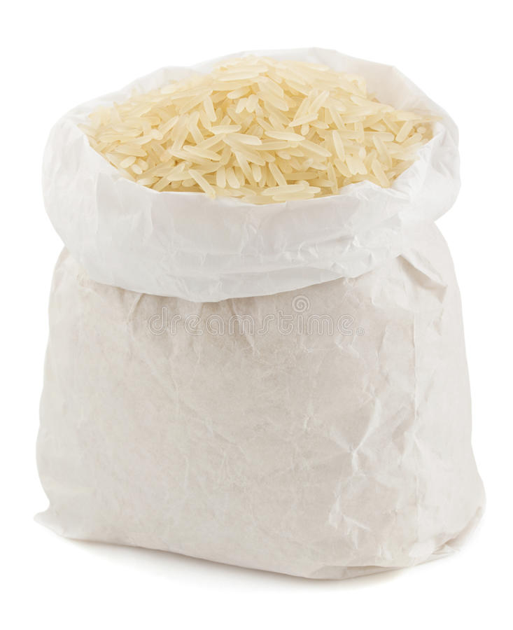
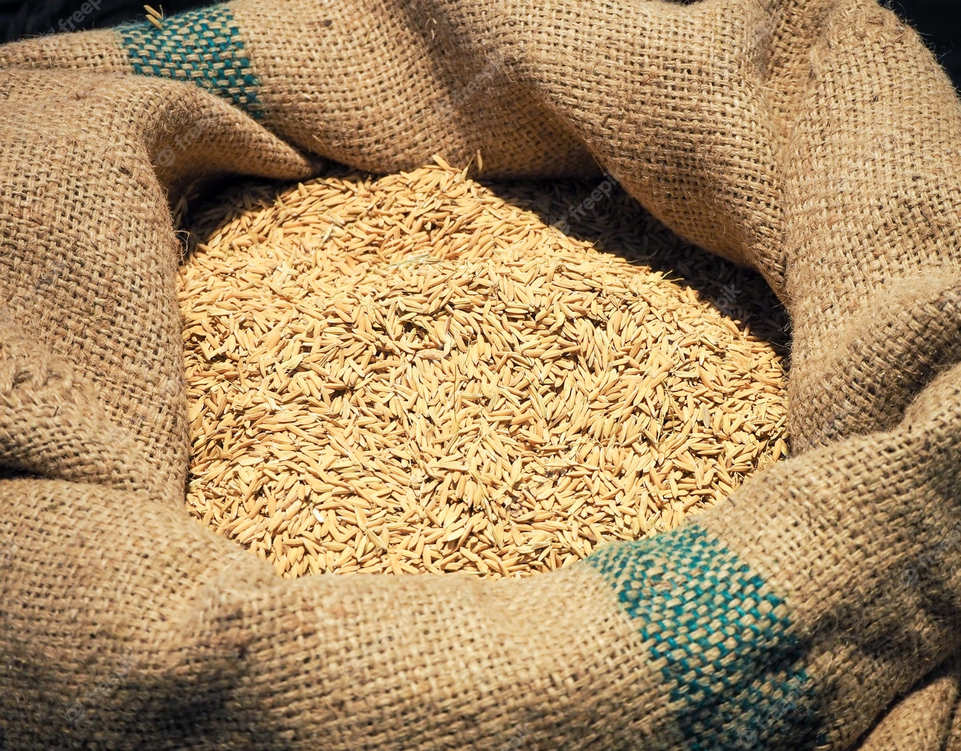
PROCESSING COSTS
Source: Meetings with Millers, Irrigation Board, distributors.
Paddy rice bag – 70Kg
White rice bag – 50Kg
PROCCESING
Waste 20-21Kg (30%)
14

Slide 15
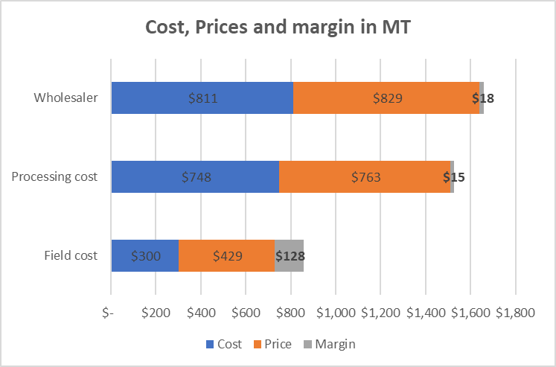
SIMULATIONS PRICES & MARGINS
15

Slide 16
PRICES IN THE MARKET
EVOLUTION ON PRICES IN MT – DOMESTIC MARKET
Source: Ministry of Agriculture
16

Slide 17
PRICE RETAIL SUPERMARKET IN MT
Source: Visit to supermarkets Mar-Apr 2023
17

Slide 18
IMPORTATIONS
PERUVIAN IMPORTS PER VARIETY IN MT
VARIETY | 2020 | 2021 | 2022 | Total general
Pilled or white | 152,238 | 108,449 | 46,944 | 307,631
Parboiled – Extra | 62,714 | 51,775 | 44,042 | 158,531
Tacuari | 80,471 | 53,998 | 23,298 | 157,767
Others | 20,178 | 19,052 | 1,935 | 41,166
TOTAL | 315,602 | 233,274 | 116,219 | 665,095
Source: Veritrade, own clasification
PERUVIAN IMPORTS PER IMPORTER IN MT
IMPORTERS | 2020 | 2021 | 2022 | Total general | %
COSTEÑO ALIMENTOS S.A.C. | 71,332 | 61,316 | 10,898 | 143,546 | 22%
COMERCIAL ISABELITA S.A.C. | 28,623 | 14,950 | 13,848 | 57,421 | 9%
PACIFIC FOODS TRADING S.A.C. | 22,826 | 12,244 | 15,062 | 50,132 | 8%
GRUPO FRAILE RICE S.A.C. | 13,342 | 16,480 | 12,643 | 42,466 | 6%
GRUPO PARCKER'S S.A.C | 18,587 | 13,880 | 8,545 | 41,012 | 6%
NEGOCIACIONES RICE FRAYLECILLO S.A.C. | 14,126 | 15,703 | 6,145 | 35,974 | 5%
OTHERS (125) | 146,765 | 98,701 | 49,078 | 294,544 | 44%
TOTAL | 315,602 | 233,274 | 116,219 | 665,095 | 100%
Source: Veritrade
18

Slide 19
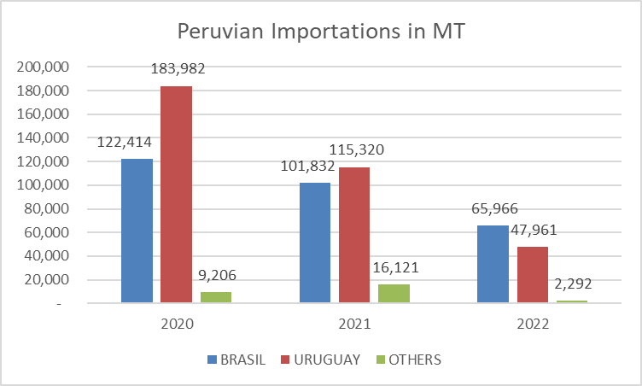
IMPORTATIONS
MAIN EXPORTERS IN MT
Source: Veritrade
PRICES TO PERU IN MT - CIF
19

Slide 20
SIMULATION IMPORTING RICE FROM URUGUAY AND PERU
REQUIREMENTS:
Import certification from Uruguay or Brazil
SENASA inspection at arrival
Bags of 1st use.
Additionally, we will need to issue the import certification.
Simulation of importing rice from Uruguay and Brazil
IMPORTS AND DUTIES
Neither from Uruguay nor Brazil have import taxes.
MFN applied: Custum duty = 0% // Ad-valorem: 0%
IVAP: 4% in the last 4 years. Doesn’t move except for a political change.
Specific fees: changes according to offer and demand. Currently US$ 38/MT
Source: Customs agents, cargo agents, MacMap, Peruvian Asociations of exporters, SUNAT, SENASA.
20

Slide 21
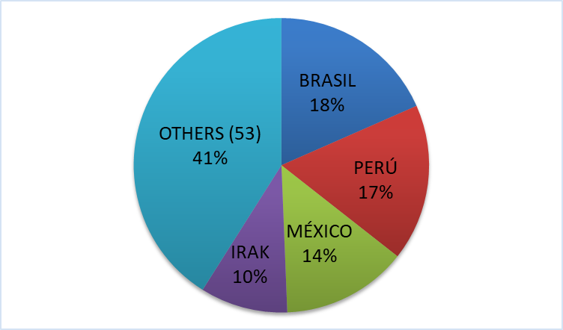
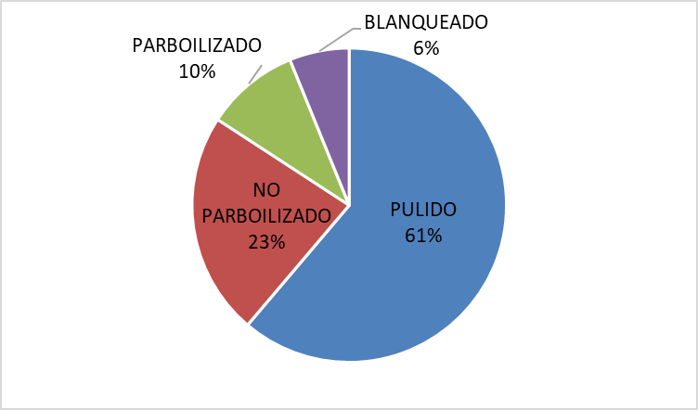
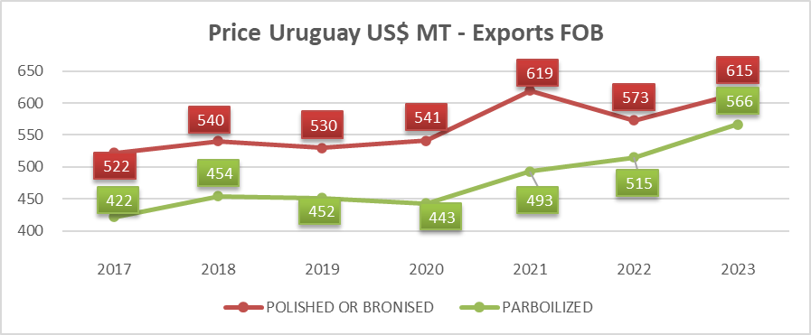
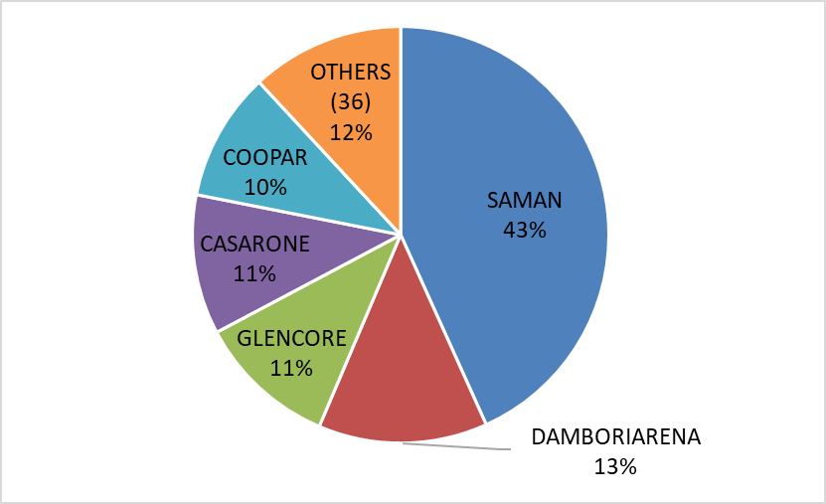
Exportations from Uruguay
Destinations
Varieties
Uruguay exports 900k MT/y
Peru imports 150k-180k MT/y from UY
770k MT/y (84%) is polished and not parboiled rice
Exporters
Source: Veritrade
SAMAN own by the Brazilian company Camil Alimentos exports 400k MT/y (43% Market share)
21

Slide 22
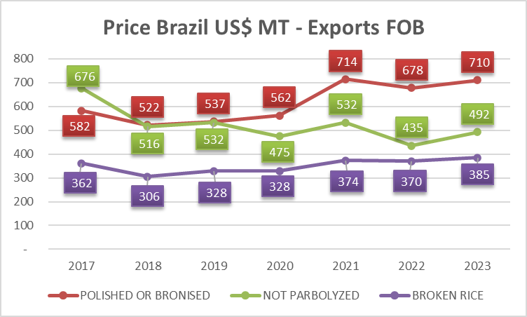
Exportations from Brazil
Destinations
Brazil has covered 154 countries in the 5 contiennts. 31% South America, 28% Africa, 22% Central American countries.
Varieties
Source: Veritrade
Not parbolized: 92% to Central & South America. Btw 400k - 1M tn/y
Broken rice: 78% Africa & 14% Europe. 300k - 400k tn/y
Polished and bronised: 50% South America and 22% Africa. 200k - 350k tn/y
22

Slide 23
Companies Acquisition

Slide 24
Description
Peru has a consolidated and informal market of rice.
Production is divided into 600 mills and 70% of the buyers are informal (without taxes).
The top companies command less than 50% but are considerably larger than the others. Main companies:
Costeño: dominates the retail market with 30% of market share.
Induamérica: dominates the supermarket packaging market, has its own brand and traditional channel.
Faraón: has a consolidated premium brand in the market.
Molinos del Norte: produces rice for supermarkets and in bulk in the traditional channel.

Slide 25
Induamerica

Slide 26

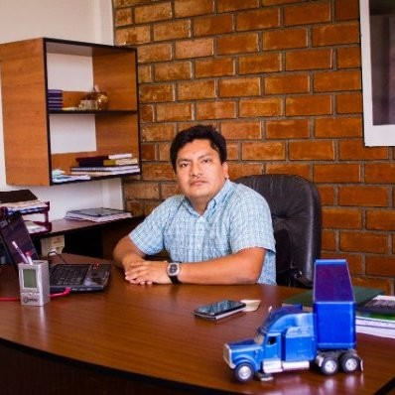

INDUAMERICA
Industria Arrocera de América SAC - Induamérica belong to Corporation ICOR, group of companies dedicated to rice, logistics and ceramic sector.
It is the biggest packer rice company in Peru with annual sales of 200k TM/y, with 19 years in the rice market.
Family business own by Perales Huancaruna family. They are 6 partners lead by Nelly Perales Huancaruna (General Manager of rice), her brother Sixto Perales Huancaruna, in charge of Logistics company, her husbands Luis Mundaca Cardozo, her siblings Orfa Zunilda, Celso David and her mother Elva Huancaruna Saavedra.
On the other side they are cousins of the biggest coffee exporter in Peru: Perales Huancaruna SAC - PERHUSA).
INDUAMERICA
PERHUSA
Nelly Perales Huancaruna
General Manager Induamerica (rice)
Sixto Perales Huancaruna
General Manager Logistics (trucks)
Arcadio Huancaruna Perales
General Manager PERHUSA (coffee)
Notes:
http://www.osce.gob.pe/consultasenlinea/inhabilitados/inhabil_detalle.asp?ruc=20479603392&fecha=09/09/2015&IdNum=0012513

Slide 27
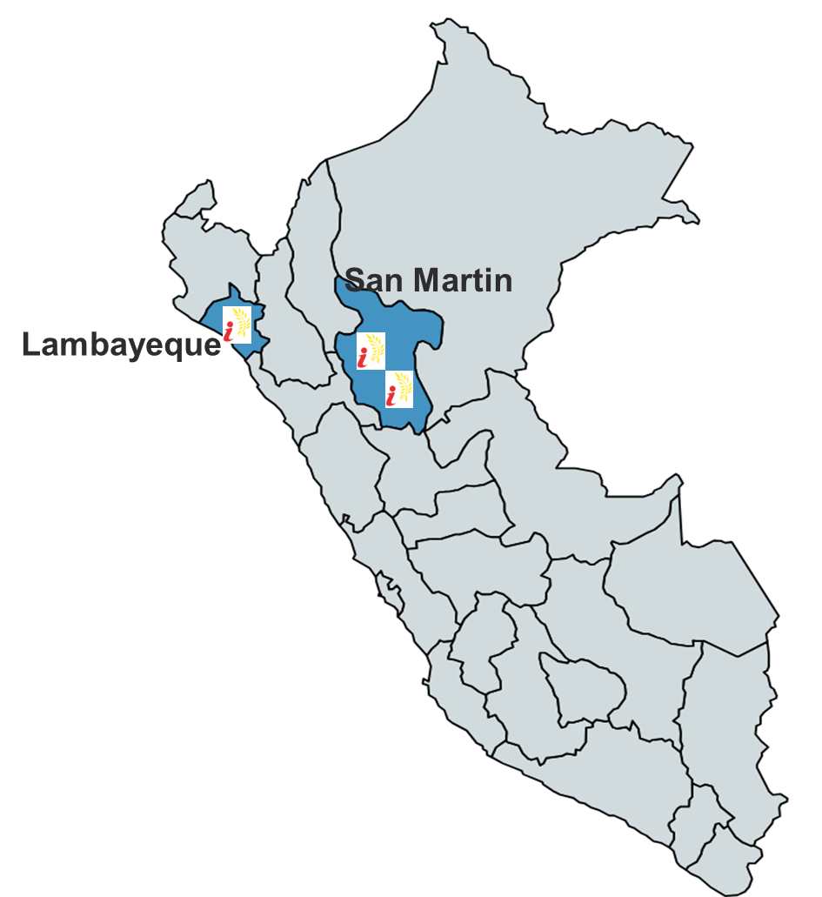
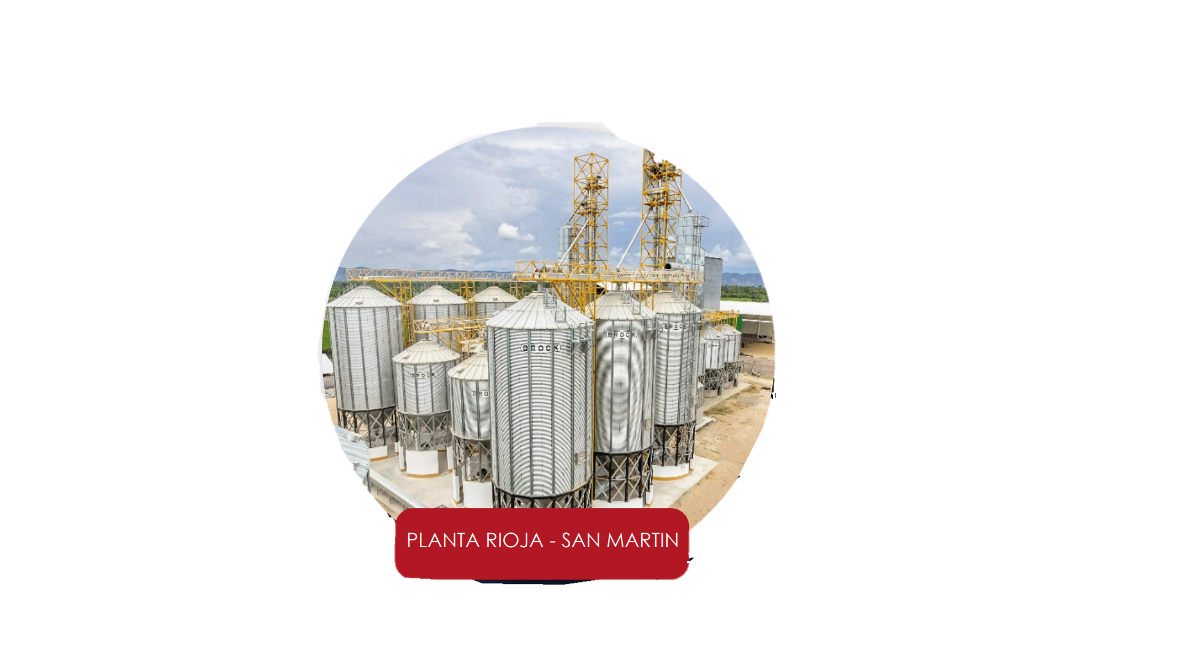
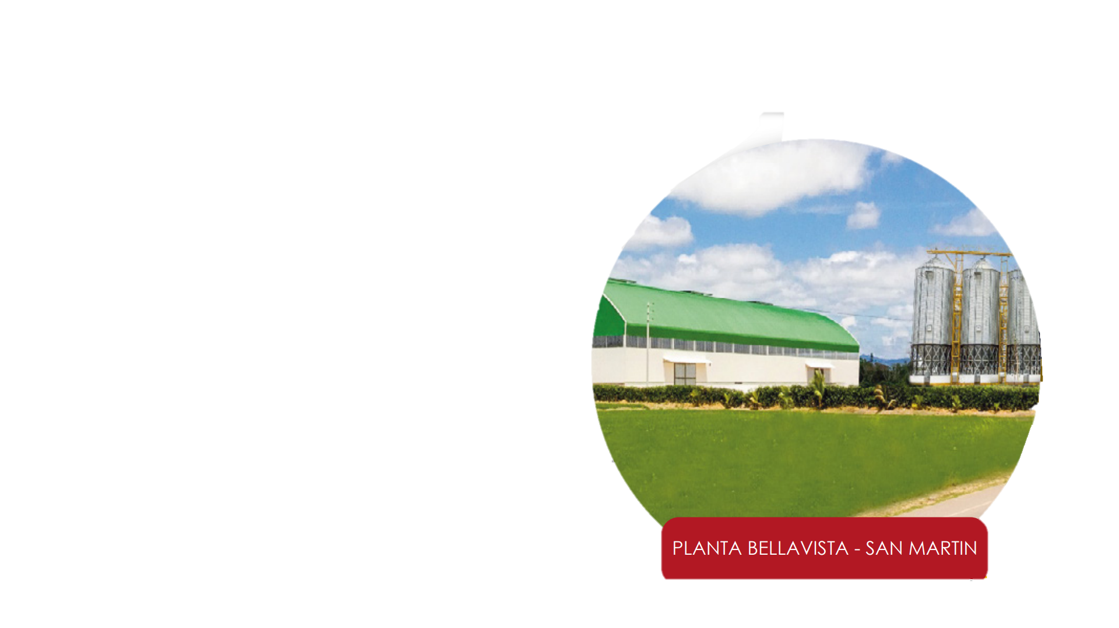
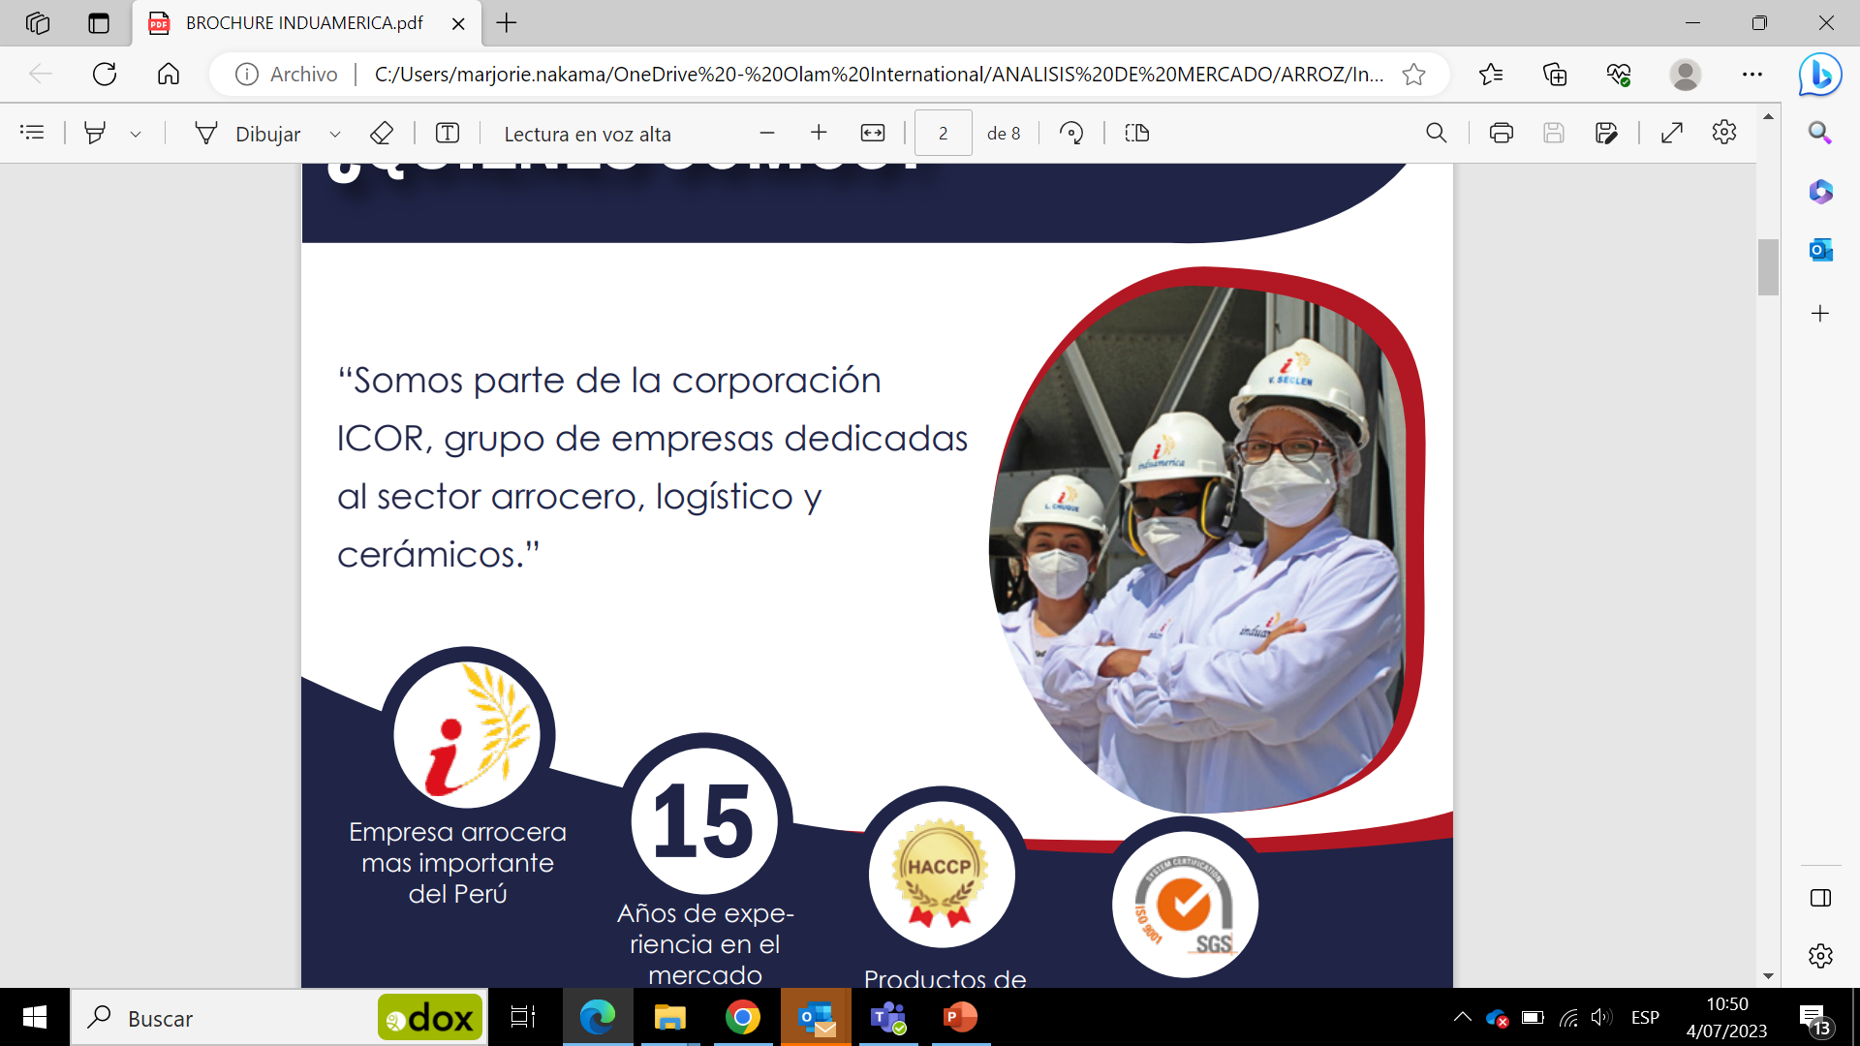
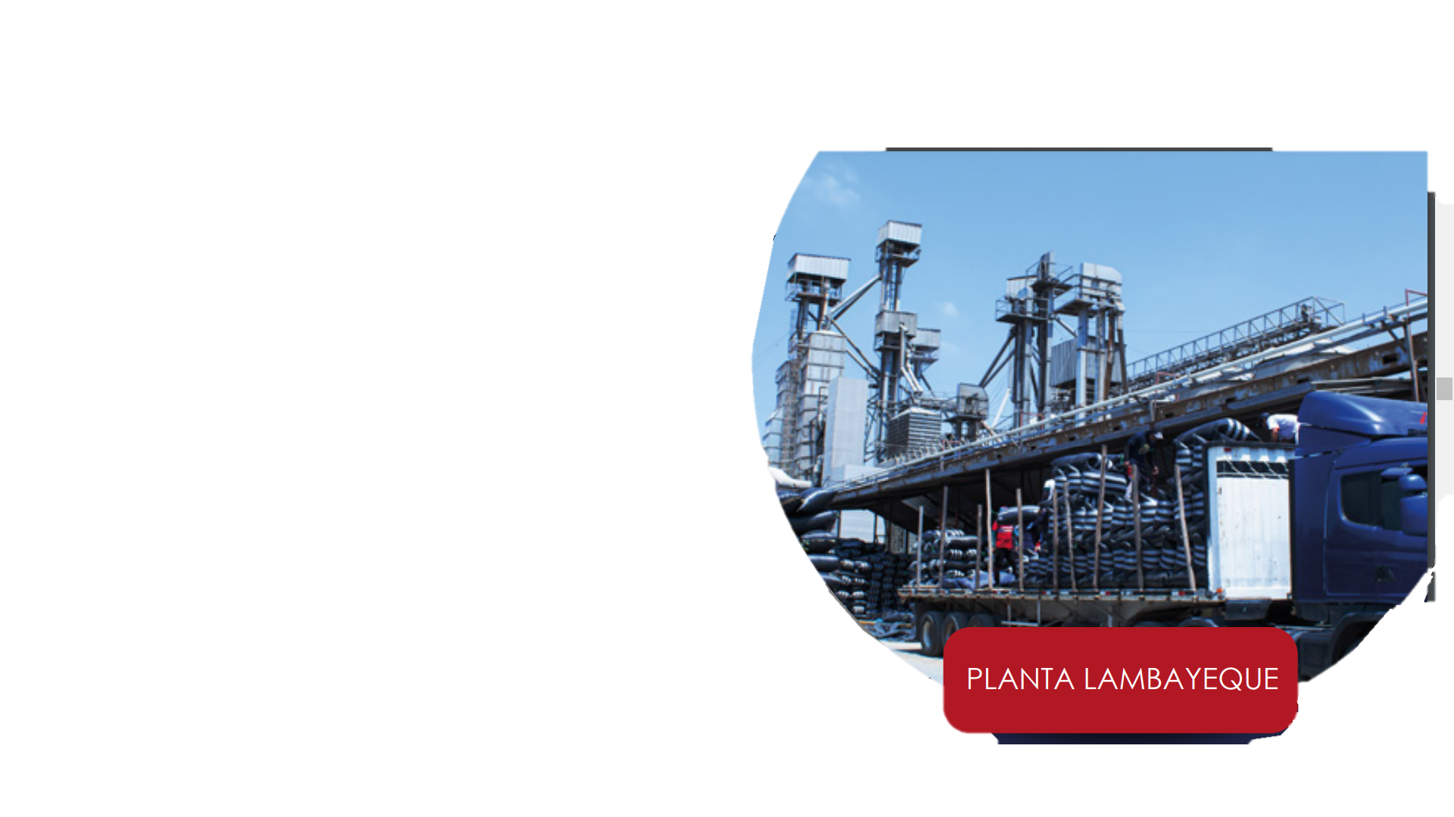
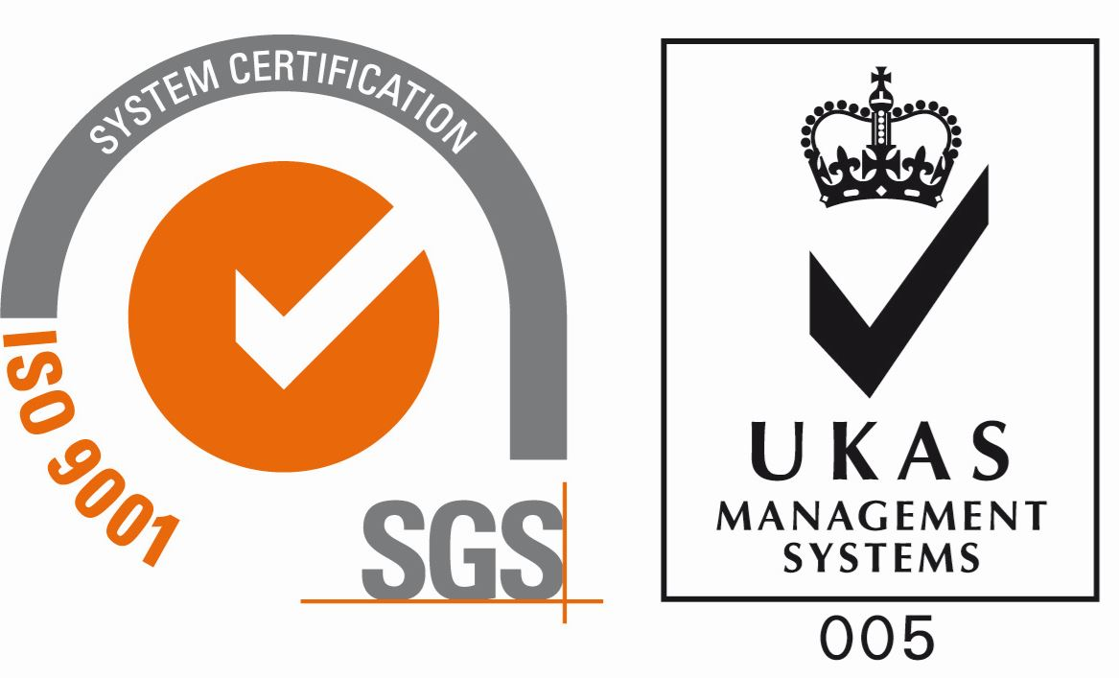
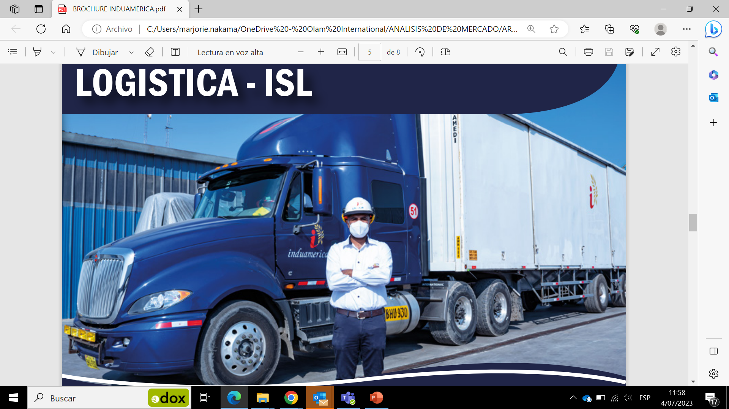

BUSINESS MODEL - INDUAMERICA
Collecting
Collect paddy rice directly from farmers in 2 main regions in Peru: Lambayeque (north of Peru) which is the biggest processing region in the country, and San Martin (jungle area), the biggest rice production (887k MT/y).
Processing
Biggest rice packer company in Peru.
They have 3 processing plants: Lambayeque, Rioja and Bellavista (San Martin). They were the 1st company to open a mill in San Martin, they decided to install facilities to be closer to farmers. Before the intermediaries bought paddy rice from San Martin and distributed in Lambayeque.
Annual production: 200,000 MT
6 certifications: HACCP, ISSO 9000, BPM.
Own a truck fleet with 220 units.
FACILITIES

Slide 28
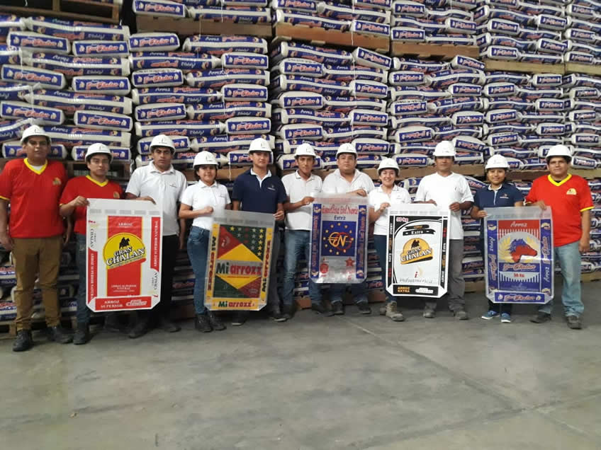
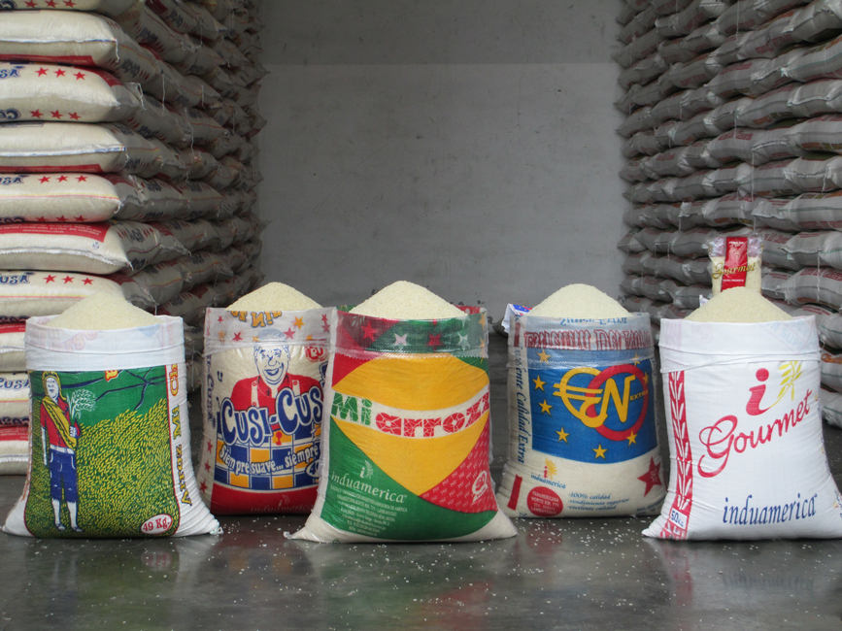
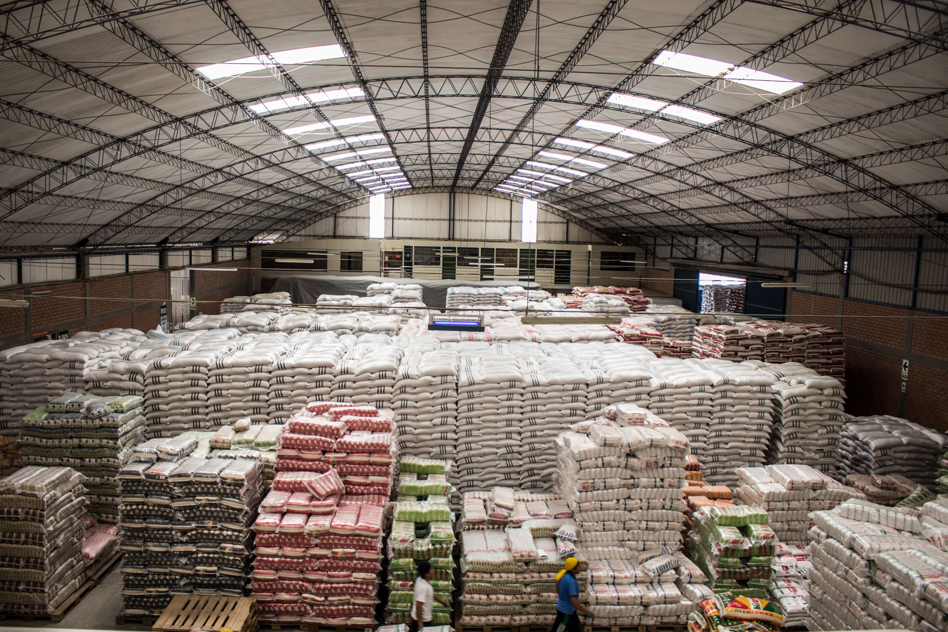
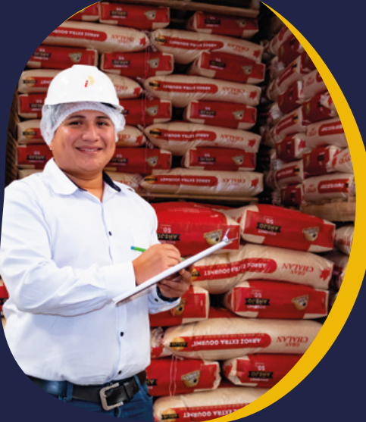
BUSINESS MODEL - INDUAMERICA
Selling
70% bulk market: represents 120,000 MT. Presentation of bags 50Kg distributed to wholesale markets, national distributions that arrive to local markets and small-town stores.
30% retail market: 25 brands between private and own brands. Sell private label brand of the biggest supermarket chains. Presentations of 750g and 5Kg. Also has 7 own brands for different segments and qualities. +15 years producing retail brands.
Market share: 8%, among 600 millers.
Clients
Government programs
Wholesaler markets
Local markets
Supermarkets and small stores.
Distribution: nationalwide.
Exportation: Ecuador and Colombia.

Slide 29
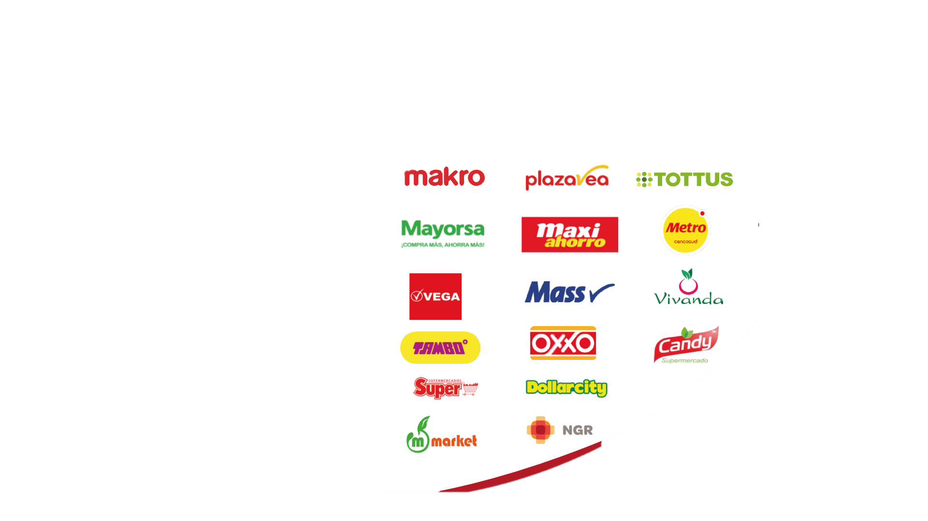
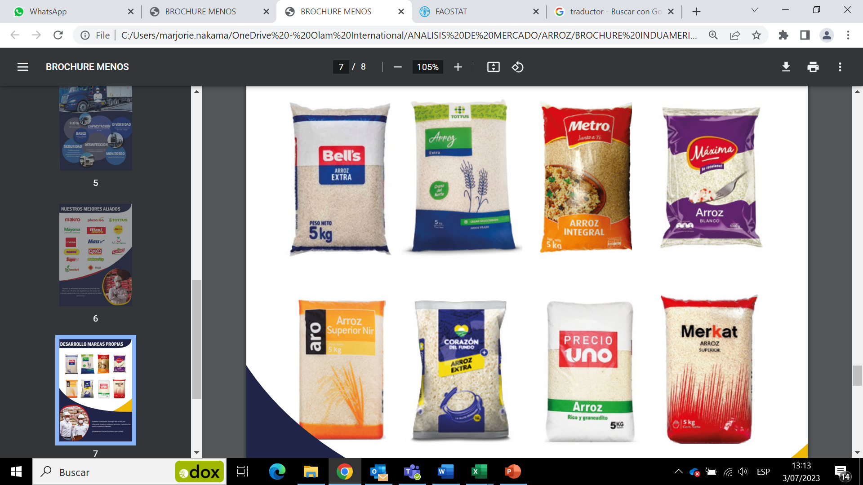
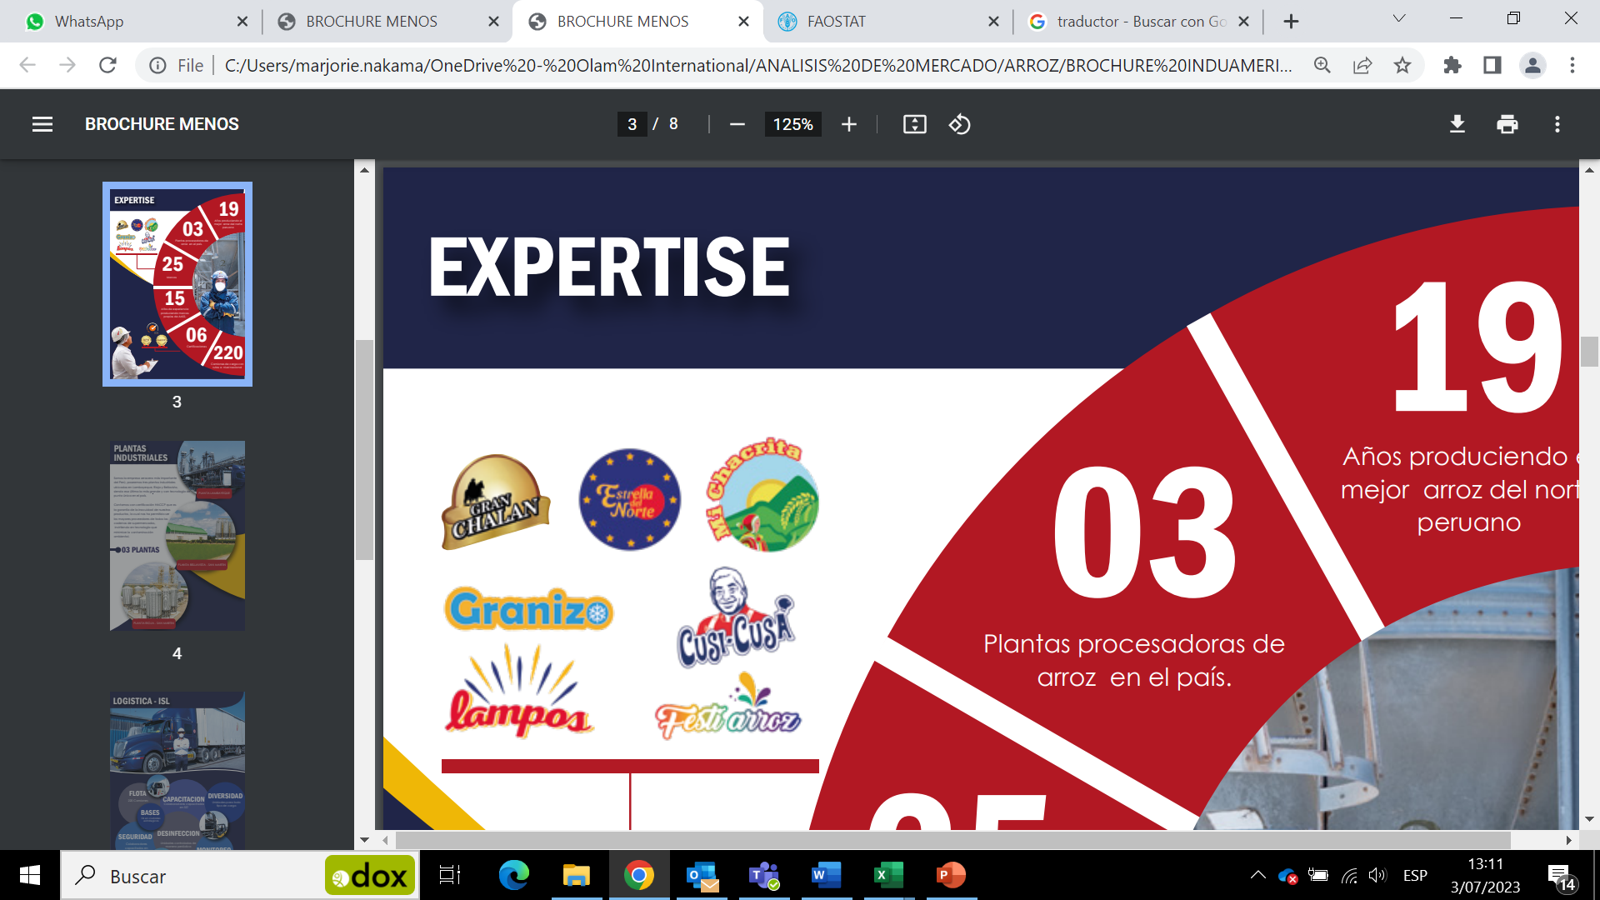
CLIENTS
MAIN RETAILERS
PRIVATE LABEL BRANDS
OWN BRANDS

Slide 30
REASONS TO INTEGRATE WITH - INDUAMERICA
They cover the whole supply chain from the farmer to the retailer. Relationship with farmers since 1997.
Efficiency in transport cost, as they have a logistic company with 220 trucks.
It is the 1st company that opened facilities in San Martin region, where the massive production of rice is.
They produce private label to the biggest supermarket chains; it is the company who covers most of the retailers.
Their main competitor is Costeño brand (the most known brand in Peru), however in total volume Induamerica is bigger in retail.
Each region in Peru is attached to regional brands, Induamerica has developed a marketing strategy to become in mid-term the biggest retailer company in the country.
Have a good connections with other millers and are open to explore opportunities, differently from their competitors.

Slide 31
Costeño

Slide 32
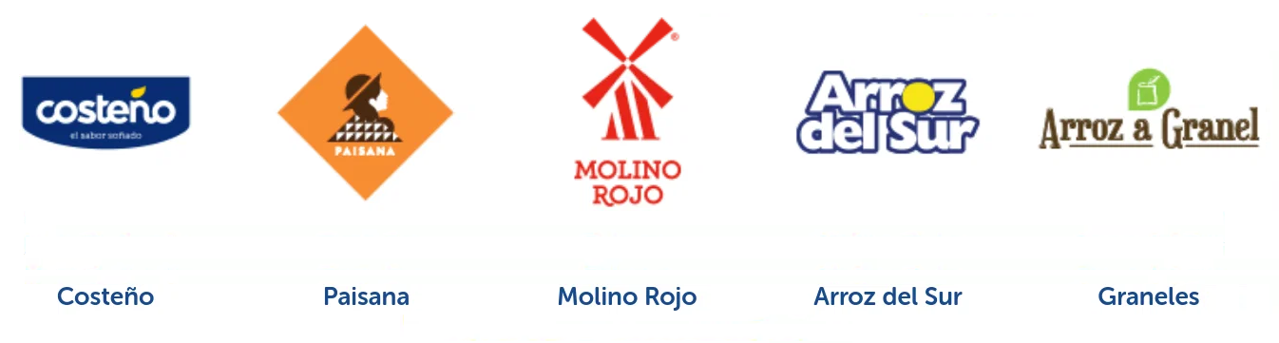
COSTEÑO
Costeño Alimentos, is the largest retail packaging company in Peru (not in bulk), it has been in the Peruvian market for more than 30 years.
In 2011 it was bought by the Brazilian multinational Camil Alimentos SA
It has several lines of business such as packaged rice, oil, sugar, beans, bulk rice, cookies and sweet preserves.
They have 3 production plants in Arequipa, Sullana and Callao.
Production: a total of 200 thousand tons of annual sales is estimated.
Costeño brand has around 40% of total market share among their other brands:

Slide 33
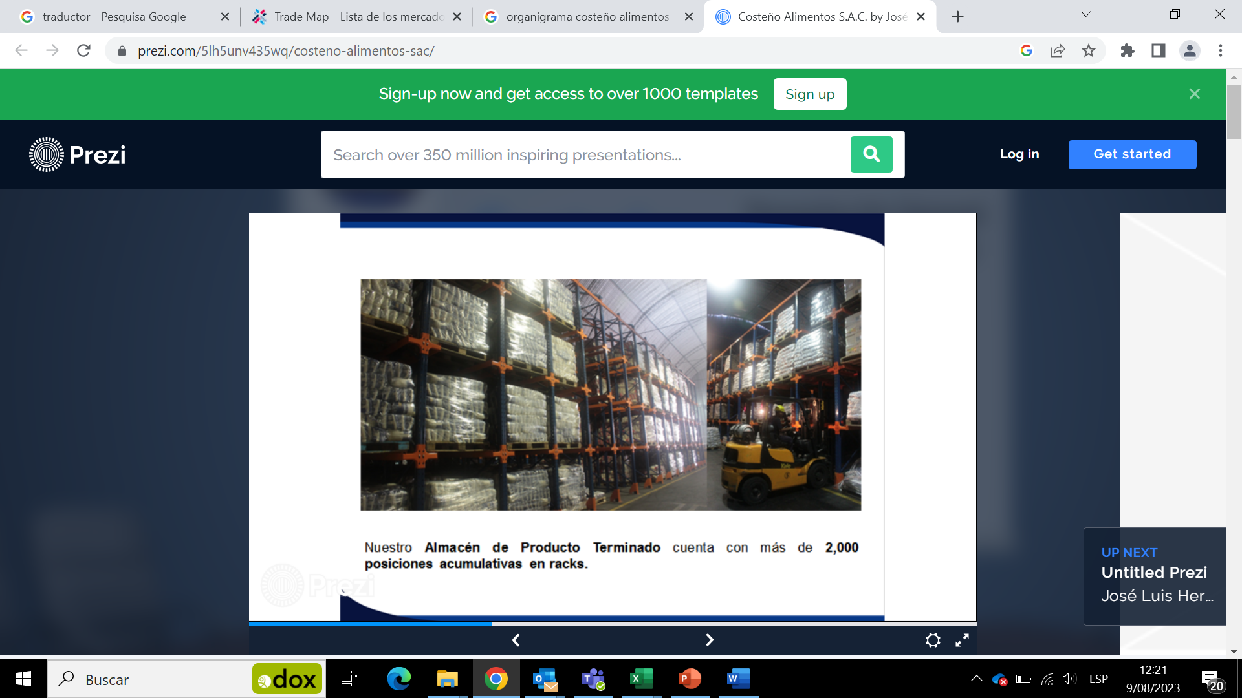
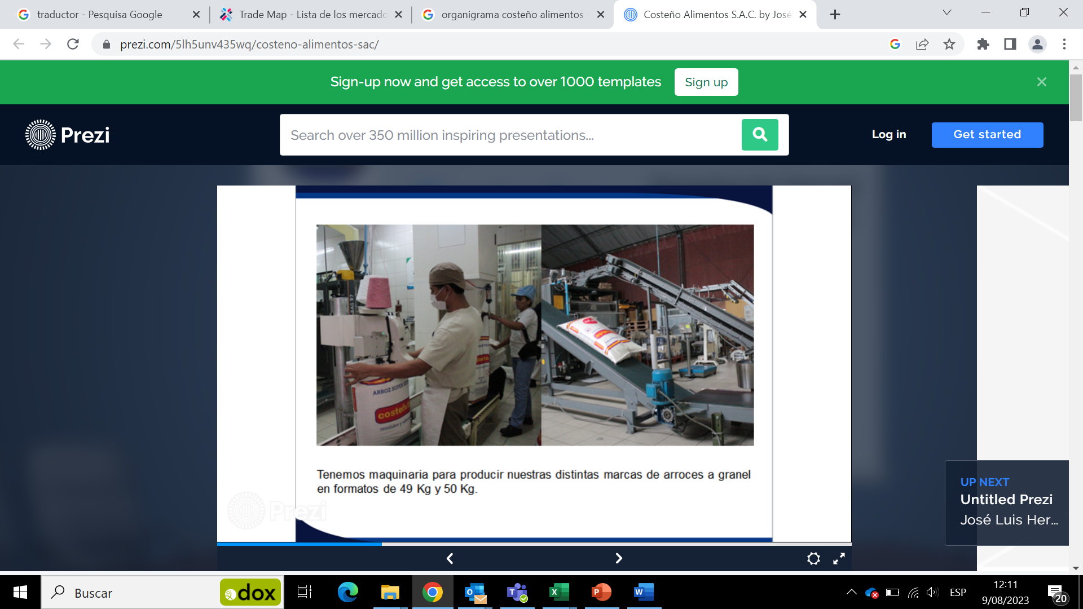
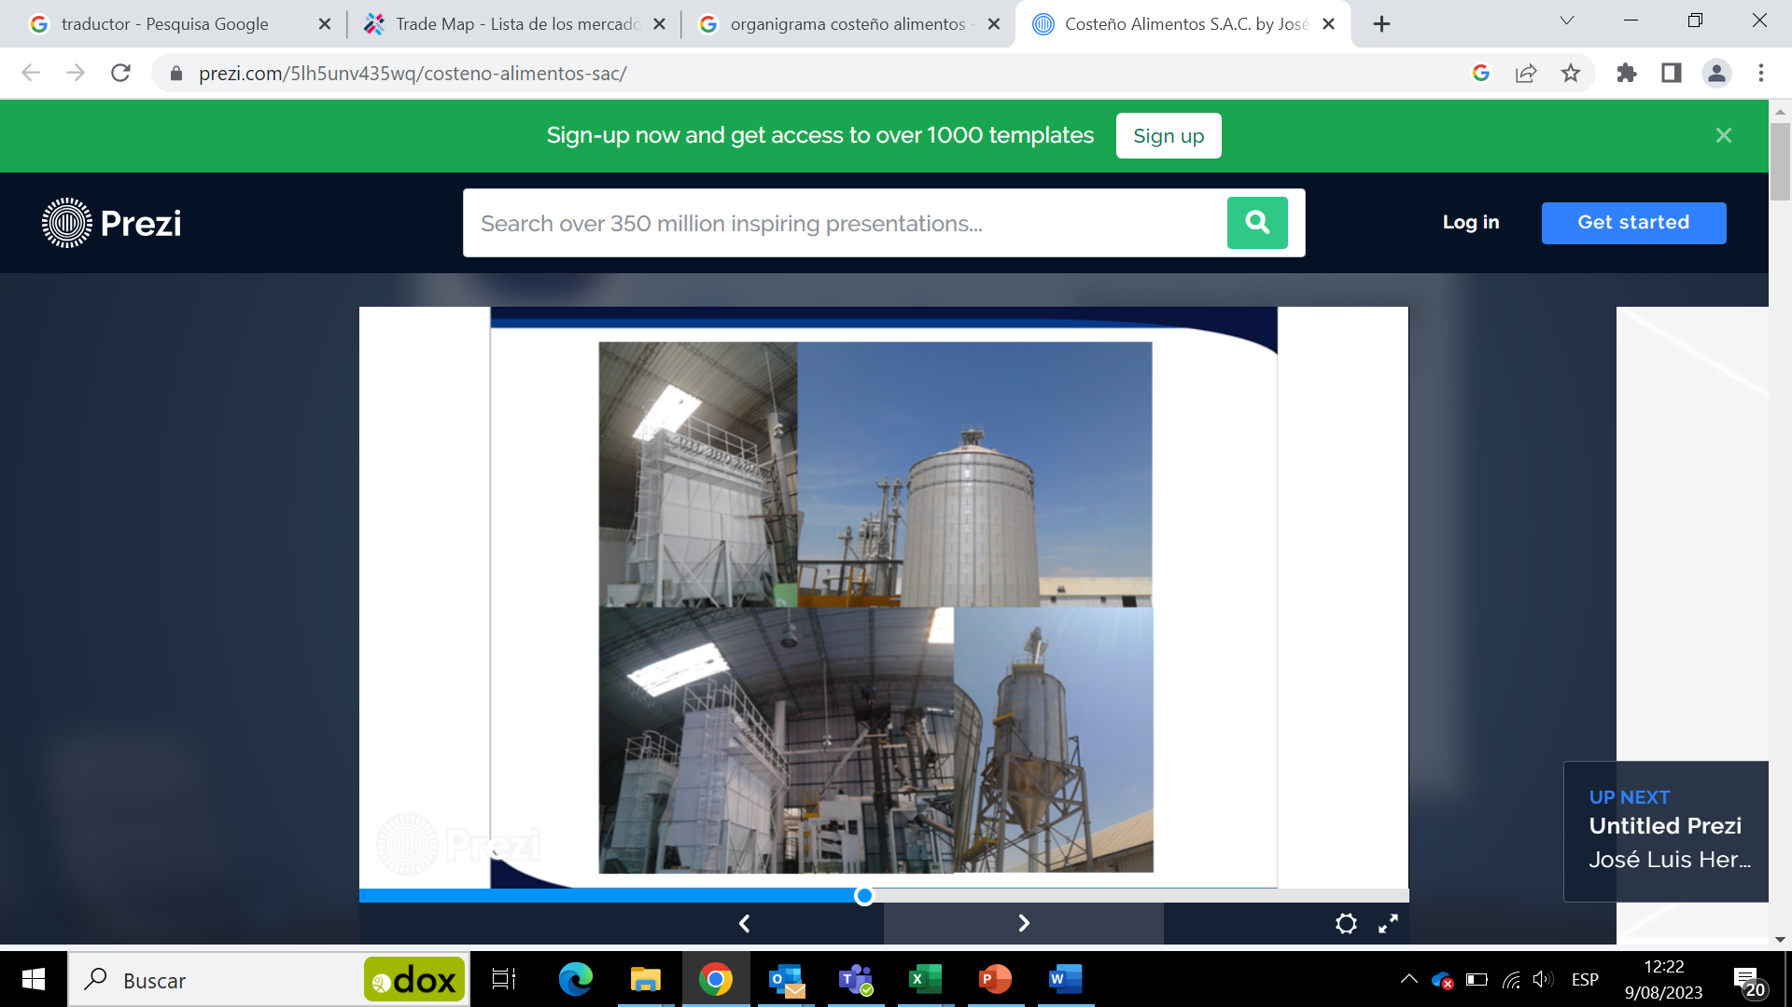
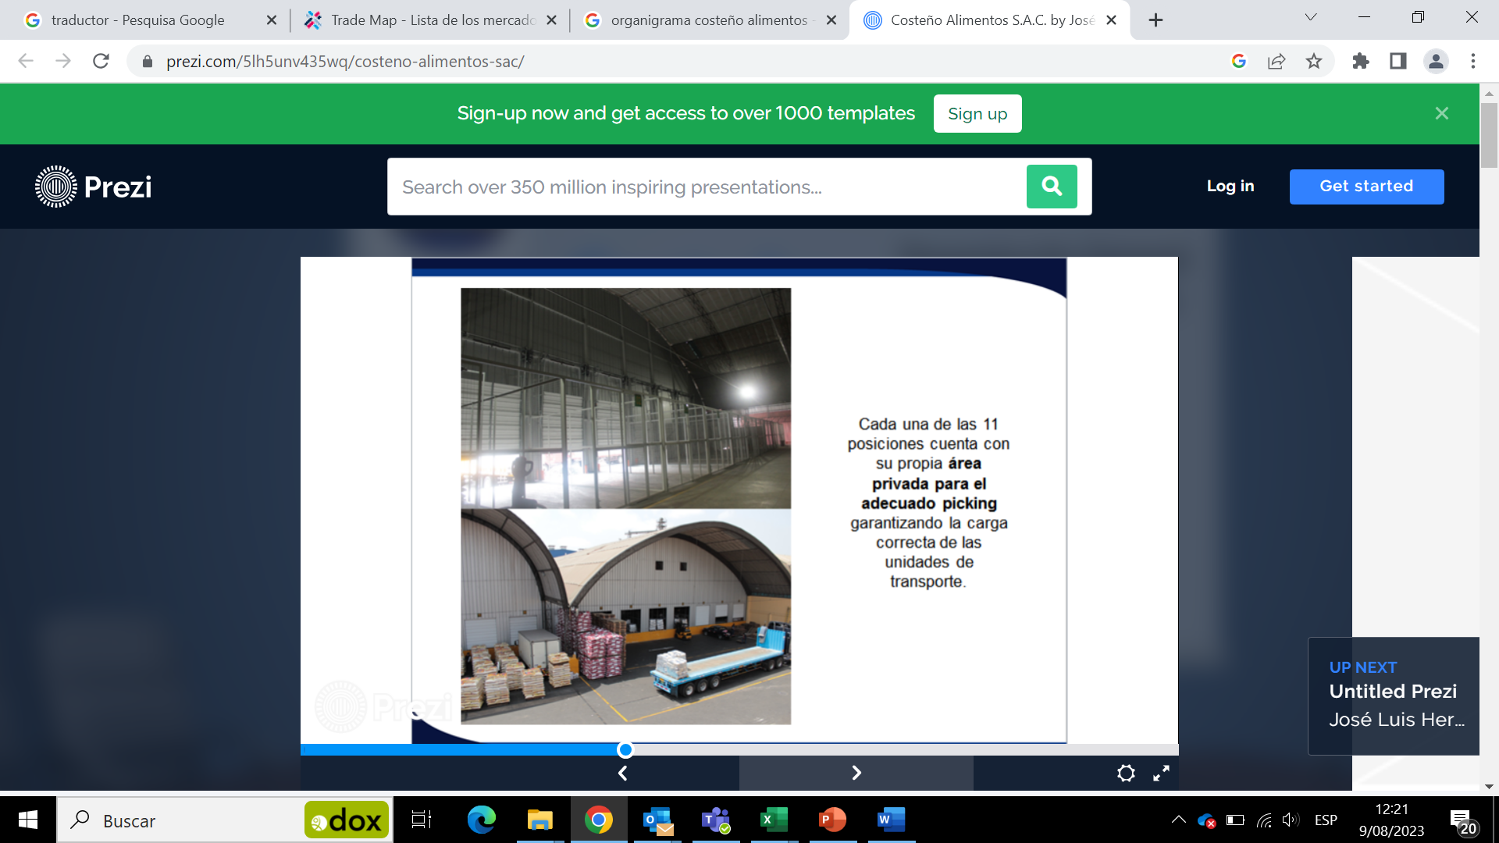
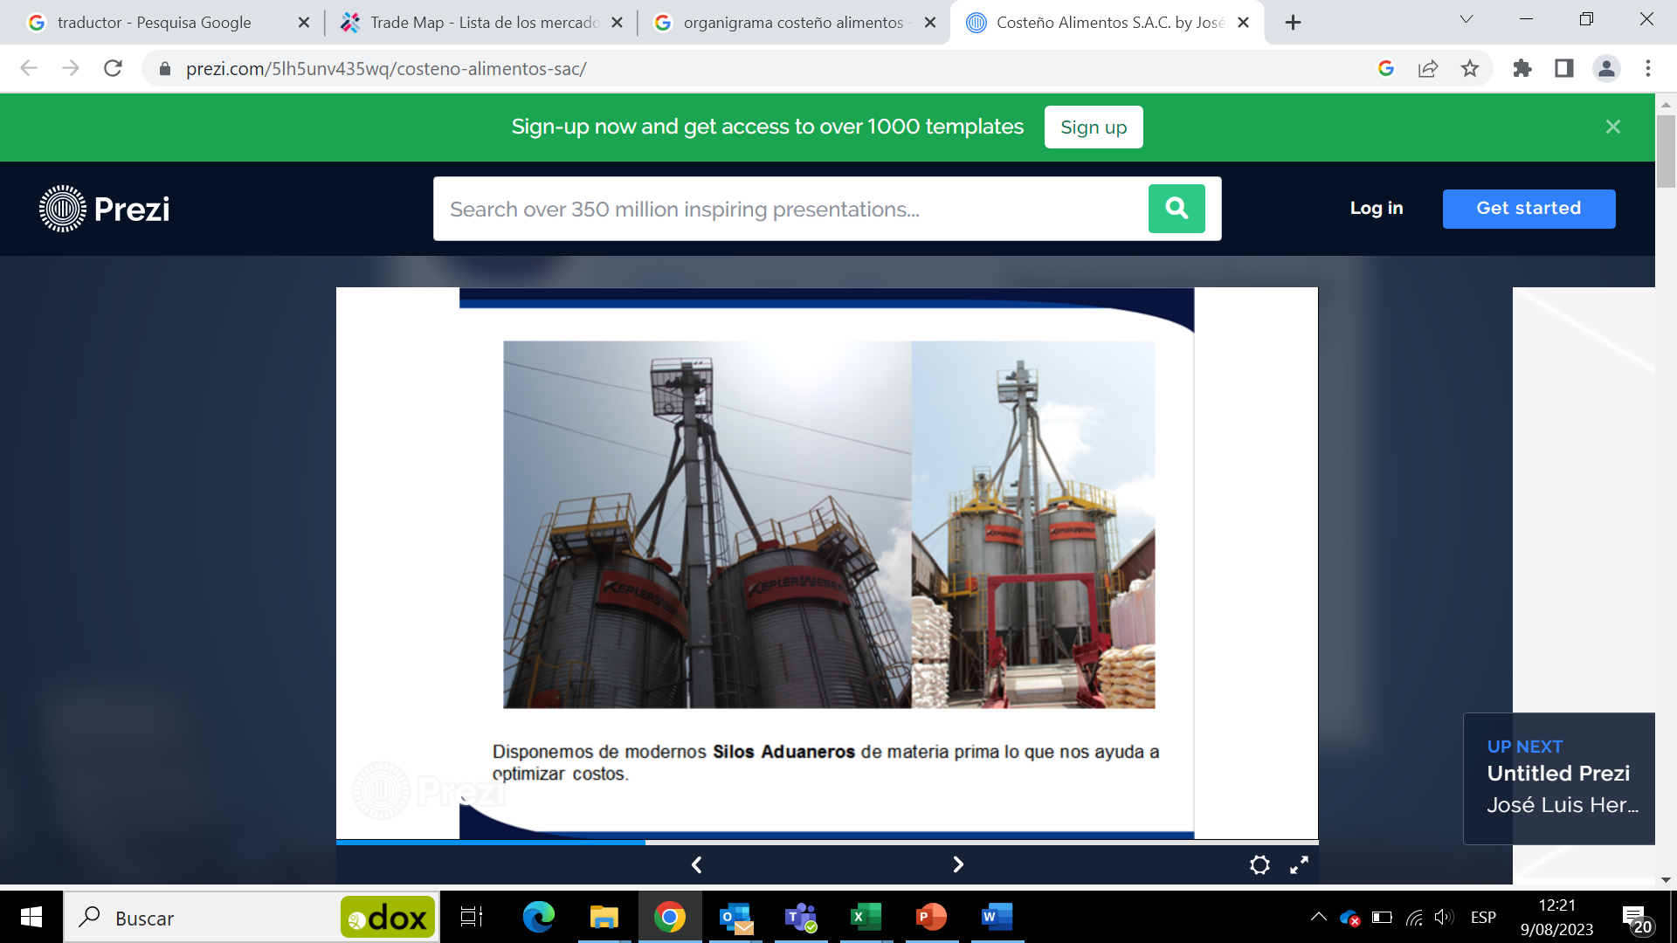
COSTEÑO CAPABILITIES
Machinery for bags from 750g to 50Kg
Customs silos and our own raw material silos with a capacity of 6000 tons each.
Warehouses with more than 2,000 cumulative positions in racks.
20 picking and delivery centers.

Slide 34
COSTEÑO CONCLUSIONS
We had a meeting with Jorge Alfaro, General Manager, whi has 27 years in rice market. He states that they are the only formal company in the market.
Costeño brand has some pirate competitors in bulk market.
Decision to sell or be acquired dependes on Camil Alimentos, currently pursuing a meeting with the person in charge.
States that is a market with low margin and big volume.
Suggested opportunities in distribution.
Discouraging position of enter in rice chain.

